Slide 1

Exploring Osteopathic Medicine for Prospective Students
2023-2024 Application Cycle
Notes:
Good morning. I am RBG. Thank you for having me today. I would like like to spend a little time talking about Osteopathic Medicine and then go into the process of applying to Osteopathy programs.
There are two ways to become a physician in the US. One of those pathways is Osteopathic Medicine. Doctors of Osteopathic Medicine of DOs are trained equally to allopathic doctors or MDs. Both require 4 years of medical schools, residency, licensure exams. DOs are trained additionally with a technique called Osteopathic Manipulative Treatment which is training to use one’s hands to diagnose and treat illnesses and ailments.
Presently, 1 in every 4 practicing physicians in the US is a DO and it is projected by the Occupational Outlook handbook of the US Bureau of Labor statistics to grow 13% through the year 2026’ faster than the average of all occupations. So by 2026, it is anticipated that all DOs will account for 33-38% of practicing physicians.
I want to start by giving a little overview about osteopathic medicine

Slide 2

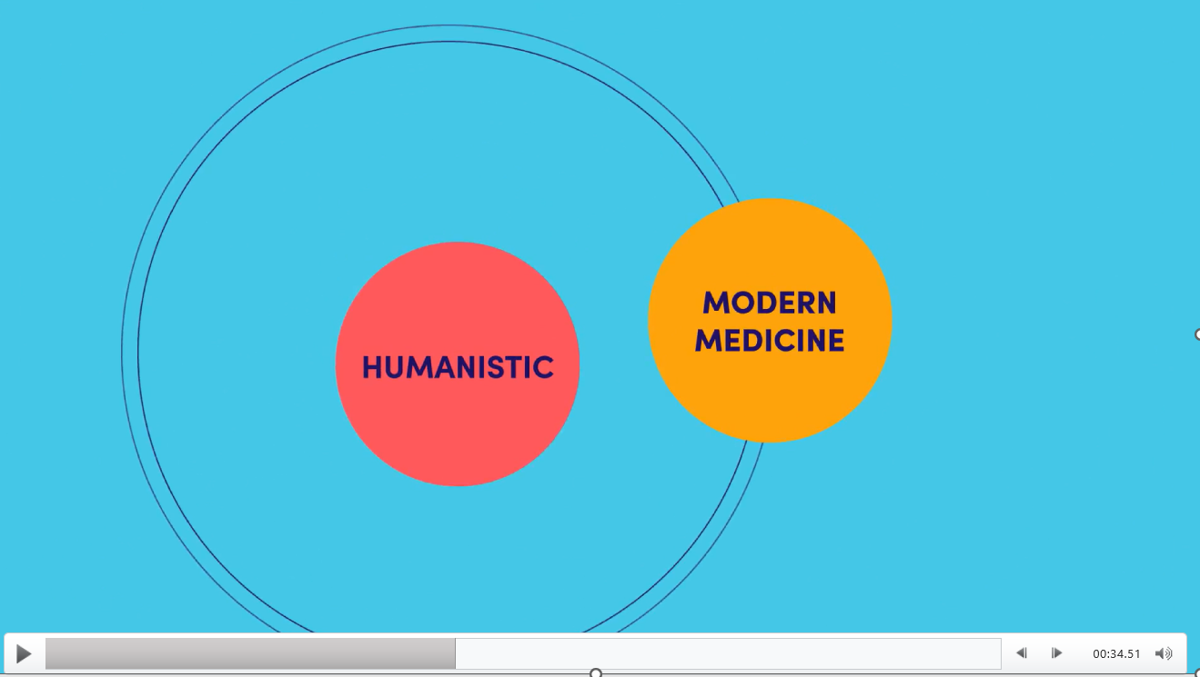
Osteopathic Medicine: From Small Towns to Big Cities

Slide 3
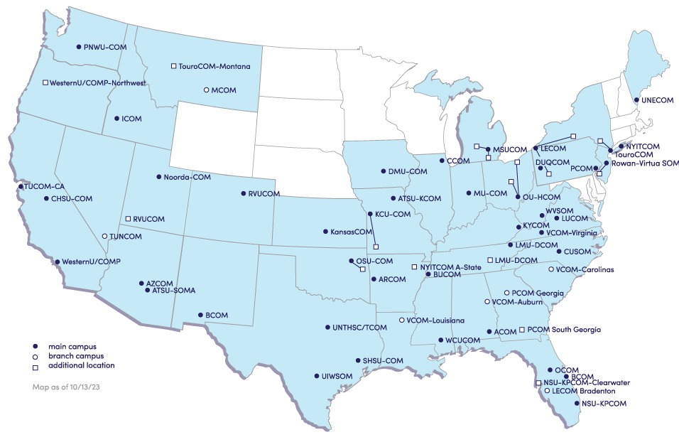
Notes:
We had recently added Baptist Health Sciences University in Memphis TN who will be added to the schools recruiting for the 2024 class.
Two additional schools have been approved that are not yet ready to recruit. One in Orlando FL and another in Pittsburgh PA.

Slide 4
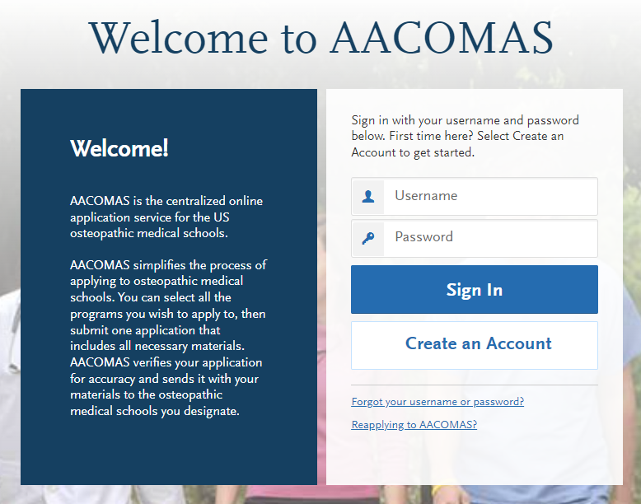
Applying through AACOMAS
Notes:
The AACOMAS System is the centralized application system which allows applicants to apply to multiple schools with one application. Schools in Texas however much apply through their state mandated system, which is Texas Medical and Dental Schools Application Service (TMDSAS).
Students must create an account in AACOMAS to being the application process. Advisors may create a test account and identify themselves as an ADVISOR so that you can see what the student experiences.

Slide 5
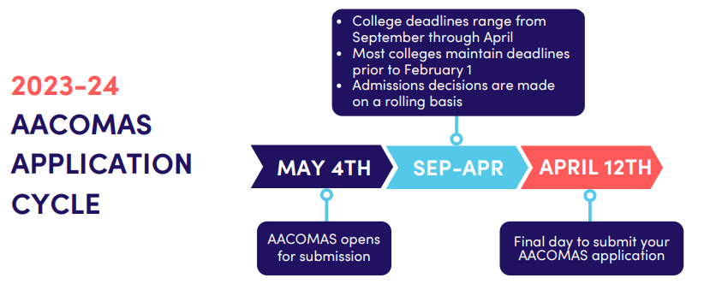
Application Timeline

Slide 6

Application Overview – The 4 Core Sections
Personal Information
  Background/biographic info
  Contact info
Academic History
  Schools attended
  Transcript entry
Supporting Information
  Evaluations
  Experiences/Achievements
  Personal Statement
Program Materials
  Prerequisites
  Custom questions
Notes:
There are 4 quadrants to be completed before one is ready to submit the application. Each section of the quadrant has instructions for the type of information needed within the section.

Slide 7

Application Overview – The 4 Core Sections
Notes:
The Personal information quadrant has 8 sections

Slide 8
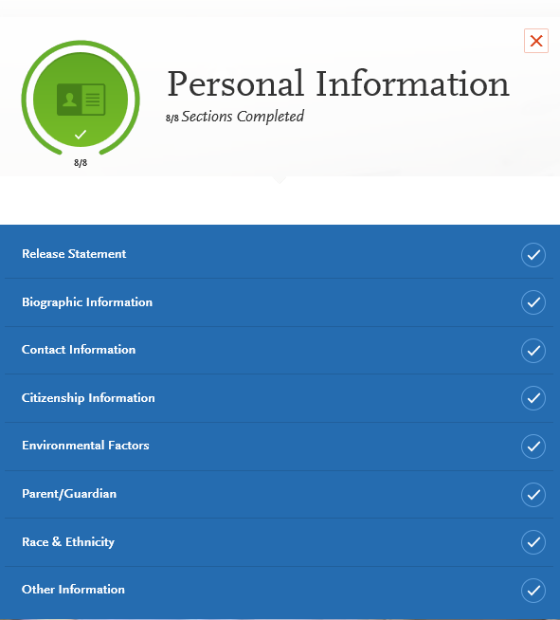
Information Collected
Birth date
Contact information
Citizenship, residency and visa information
Race and ethnicity
Spoken languages
Criminal history and academic or professional infractions
Notes:
Release statements allow applicants to release contact information prior to the application submission to the COMs whose programs have been selected. Providing access to the advisors allows for advisors to assist with accessing the status updates if necessary. Influences references who, in the applicants experience influenced their decision to become a physician.

Slide 9
Application Overview – The 4 Core Sections
Notes:
Academic History has 4 sections allows for entry of educational institutions attended, transcript information, continuing education courses and standardized testing scores.

Slide 10
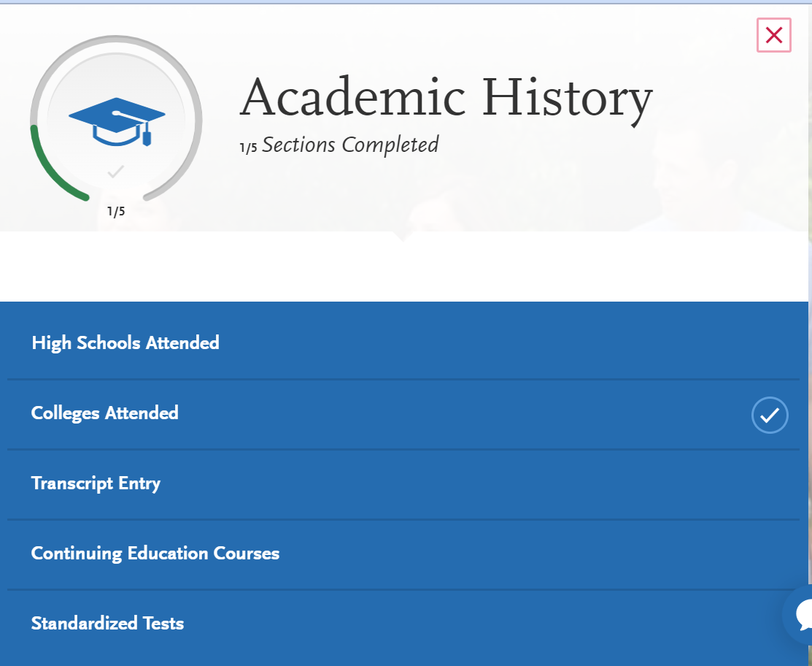
Notes:
Academic History has 4 sections allows for entry of educational institutions attended, transcript information, continuing education courses and standardized testing scores.

Slide 11


Sending Official Transcripts & MCAT Scores to AACOMAS
Transcripts must be sent to AACOMAS from all US and English-speaking Canadian institutions you listed in the Colleges Attended section of your application, even if the courses later transferred to another institution.
Do not send foreign transcripts (non-US/non-English-Canadian). This includes transcripts from Caribbean and French-Canadian schools.
You must request that AAMC release your MCAT scores to AACOMAS. After AAMC processing, scores are sent to AACOMAS in batches and then posted to applications daily. You can view scores attached to your application in the Standardized Tests section of the Check Status tab.
Notes:
Transcripts must be sent to AACOMAS from all US and English-speaking Canadian institutions you listed in the Colleges Attended section of your application, even if the courses later transferred to another institution
Do not send foreign transcripts (non-US/non-English-Canadian). This includes transcripts from Caribbean and French-Canadian schools.
You must request that AAMC release your MCAT scores to AACOMAS. After AAMC processing, scores are sent to AACOMAS in batches and then posted to applications daily. You can view scores attached to your application in the Standardized Tests section of the Check Status tab.
The Colleges attended and the Standardized Test sections are in the Academic History quadrant of the application.

Slide 12
Application Overview – The 4 Core Sections
Notes:
Supporting information has 4 sections

Slide 13
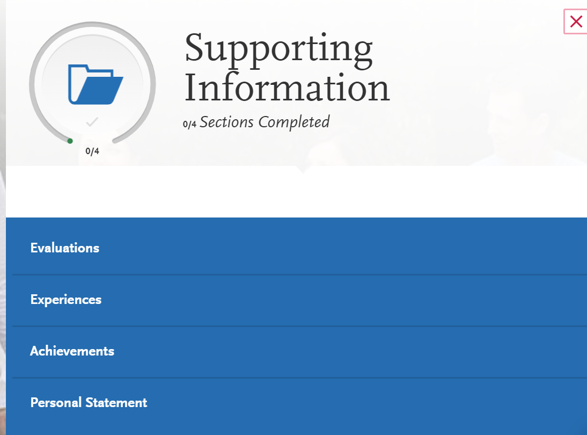
Notes:
Supporting Information provides the applicants space to provide detailed information that supports the applicants desire to be considered as a viable candidate. In this area, applicants my submit their evaluations from EXPERIENCES (letters of evaluations, letters or reference or recommendations), share experience and achieves and provide their personal statements which should highlight who you are as an individual and what being a physician and in particular an osteopathic physician means to you.

Slide 14
Application Overview – The 4 Core Sections
Notes:
Program Material has 2 sections

Slide 15
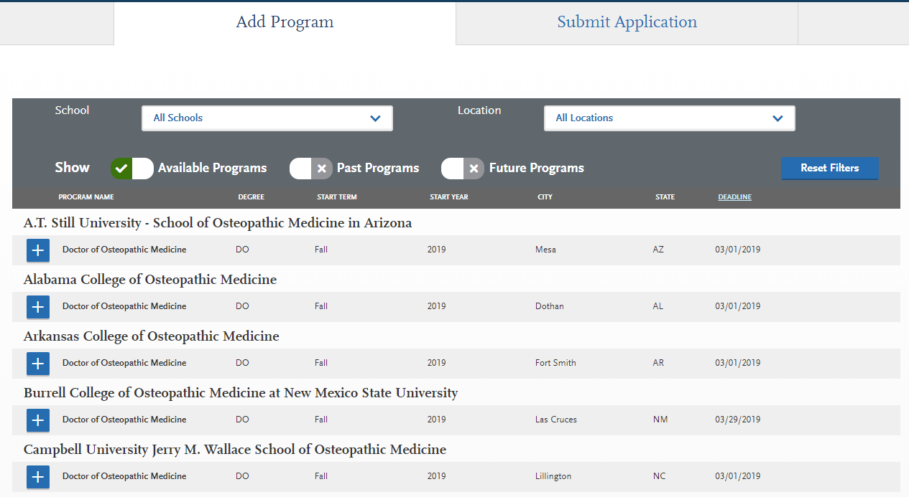
Section 4: Program Materials
Notes:
This is just a depiction of how the page looks for applicants to select the programs to which they plan to apply

Slide 16
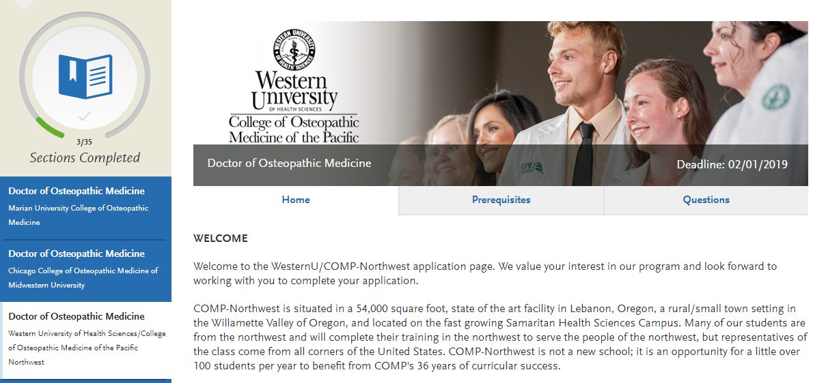
College Pages
Notes:
Each main and branch campus has a college page that provides information to the applicant to assist them with their selections of programs within the application process. This should NOT be confused with DO Explorer which can be accessed from the AACOM website.

Slide 17
What Does it Cost to Apply?
Primary Application fee = $198
Additional Designation = $55
  AACOMAS Fee Waiver Program covers the initial application fee only.
    Qualifies applicant for consideration of additional designation waivers at the COMs discretion

Slide 18
Fee Waiver Program Overview
Purpose: To encourage financially disadvantaged applicants to become DOs
Impact: Approximately 1182 fee waiver recipients were issued in the 2022-2023 application cycle.
Current Eligibility Requirements & Process
Household income level below 200% of federal poverty guideline
Must submit previous year’s tax return for manual review
If claimed as a dependent, must submit parent/guardian’s tax return
Notes:
The fee waiver process is to provide access for lower income individuals who have a desire to be a physician

Slide 19
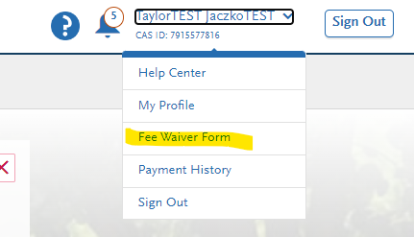
Fee Waiver Program
Fee waiver application is embedded in AACOMAS
Waiver must be requested and approved BEFORE the AACOMAS application is submitted
Once approved, the AACOMAS application MUST be submitted within 14 days or the waiver will be forfeited
Colleges may waive their secondary application fees for students who receive an AACOMAS fee waiver

Slide 20

New for the 2023-2024 AACOMAS Cycle
AACOMAS will begin processing applications as they are submitted, which will begin the day of the application launch (May 4, 2023)
Ability to edit in-progress experiences after submission

Slide 21
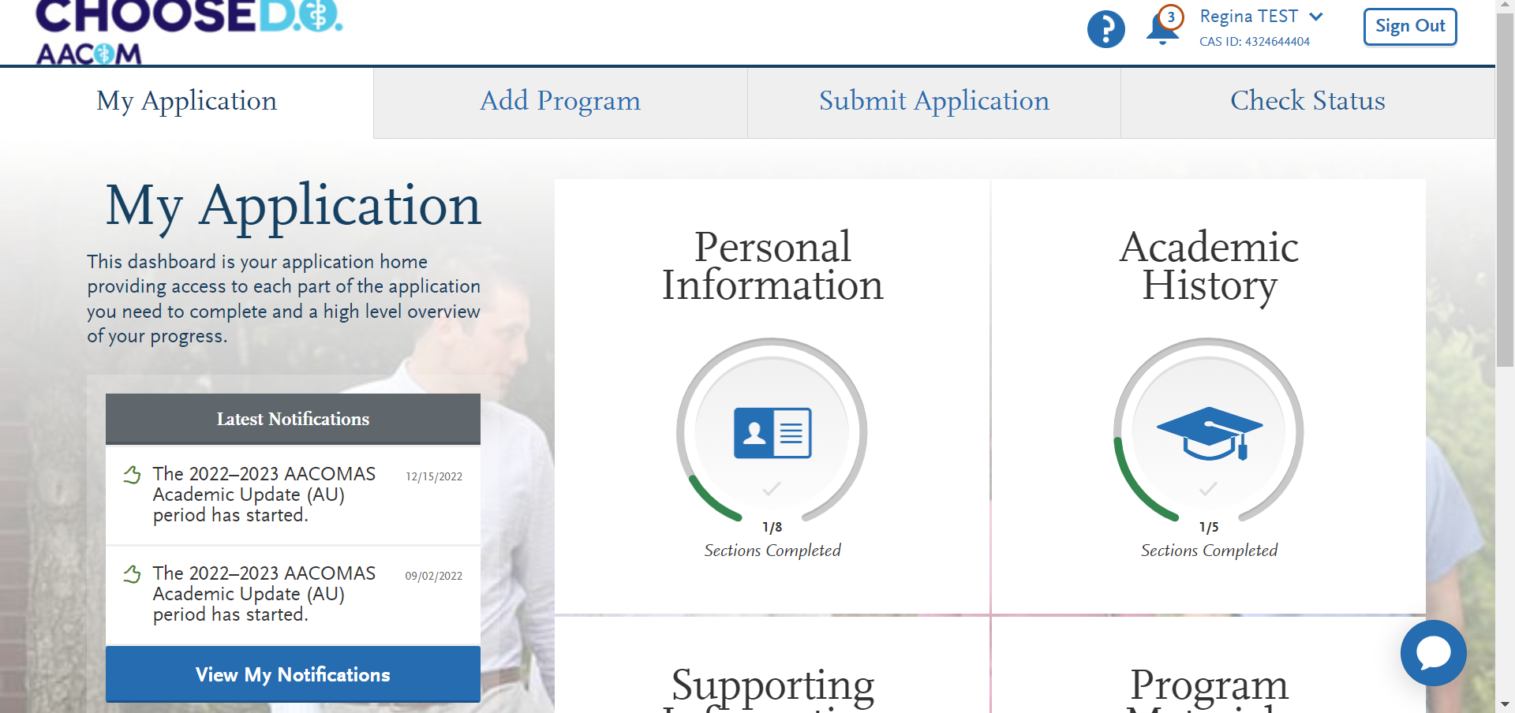
Checking the status of an application

Slide 22
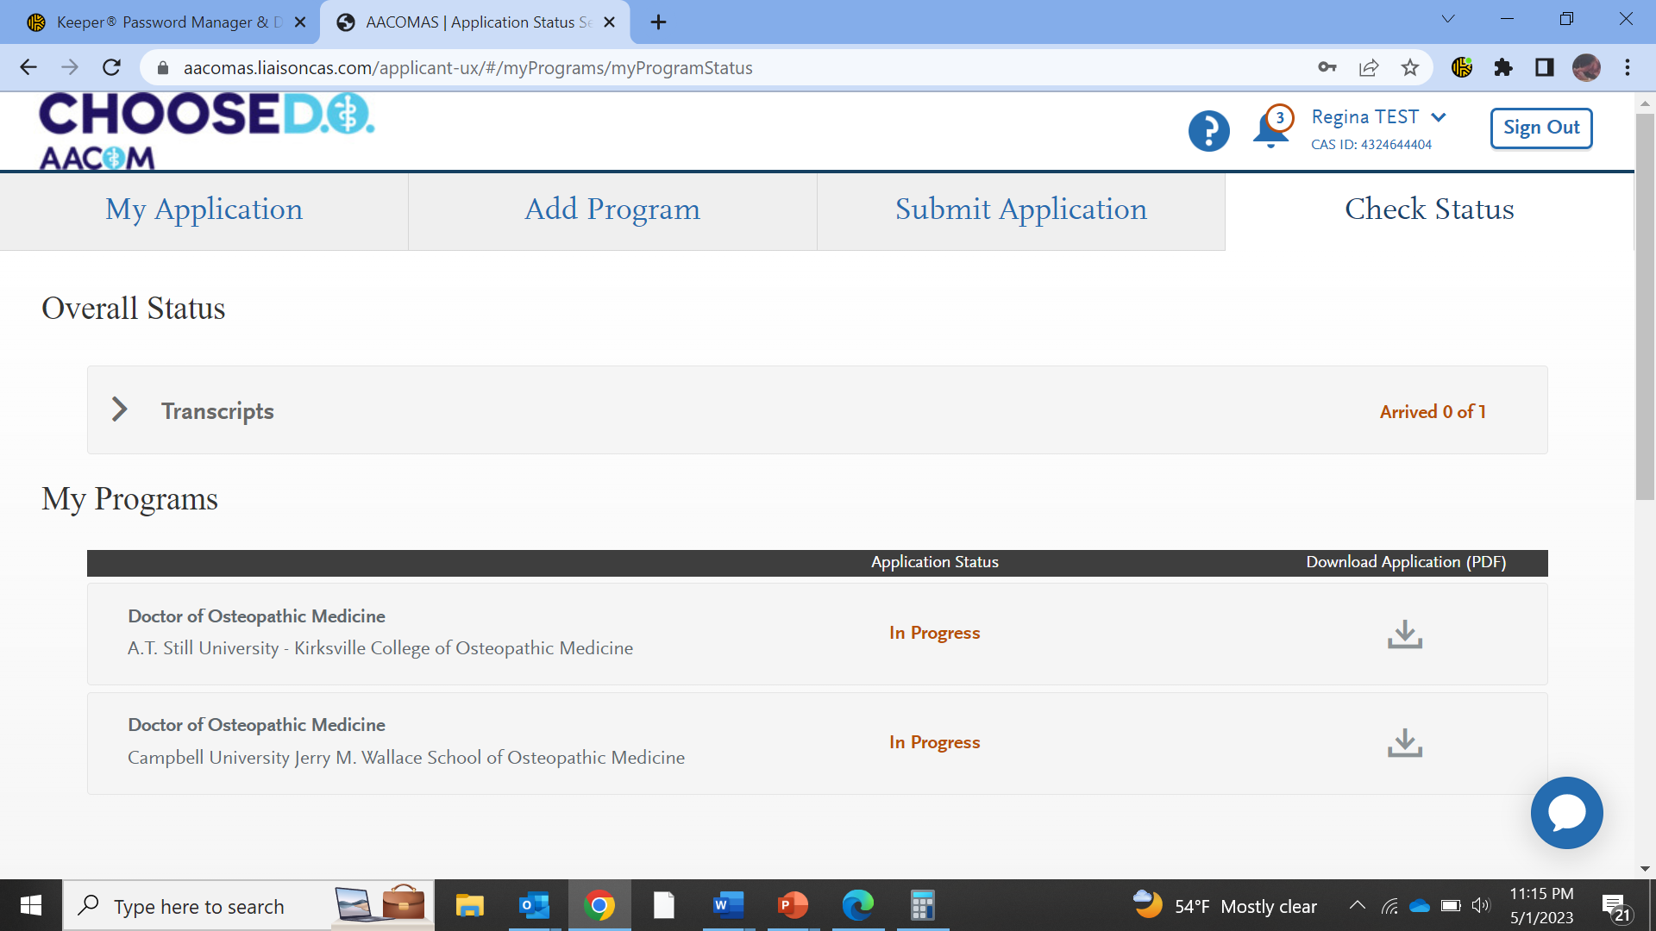
Notes:
The applicants status will show for each program selected. Once an application has been started in will be in progress until submitted.

Slide 23
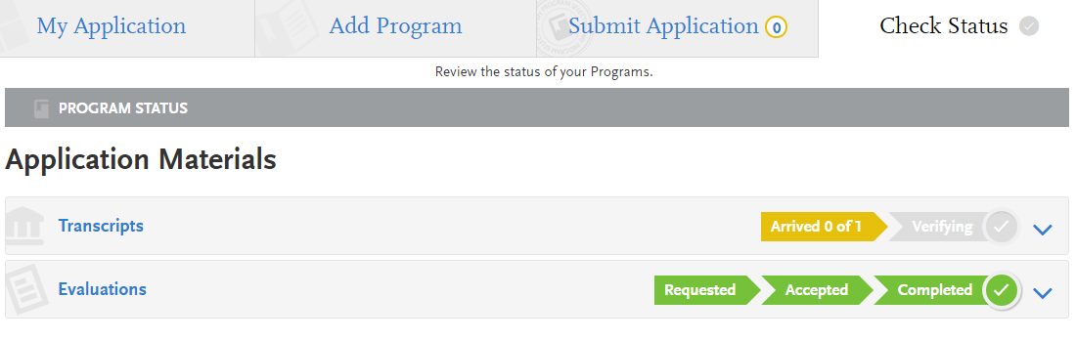
Submitting and Monitoring Your Application
In Progress
Received / Incomplete
Complete
Verified
Notes:
Applicant application statuses:
In Progress – started the application and have not submitted.
Received – submitted the application but waiting for official transcripts to begin the verification process.
Complete – transcripts received from all colleges/universities and ready for verification.
Verified – application verified, and GPA calculations are available.

Slide 24
Post-Submission Edits
Once you submit your application, most sections are locked to prevent edits. Updates you can make include:
Editing your contact information.
Editing your profile information (username, password, etc.).
Modifying your release statements
Adding programs with deadlines that have not yet passed.
Adding new evaluations (if you have not yet requested the maximum number of evaluations).
Editing or deleting evaluations that remain incomplete.
Adding new entries to certain areas of the Academic History, Supporting Information, and Program Materials sections (e.g., test scores, experiences, optional documents, etc.), where applicable (you are unable to edit or delete existing entries).
Editing In-Progress Experiences.
Editing program materials for programs you have not yet submitted to.
Adding optional documents to programs that you already submitted to (all other sections will be locked).

Slide 25
Academic Update Periods
There are 3 periods at which applicants may go into their applications and update information.
Academic Update 1: September 1, 2023 – October 13, 2023
Academic Update 2: December 15, 2023 – February 16, 2024
Academic Update 3: March 15, 2024 – April 12, 2024
Notes:
Applicants may use 2 of the 3 update periods to make changes to their applications on academic information.
Applicants receive notifications within AACOMAS when the academic update periods are open and available.
You may update any coursework that is in progress or planned and well as adding courses planned for the next term and grades for courses that were in progress at submission.

Slide 26
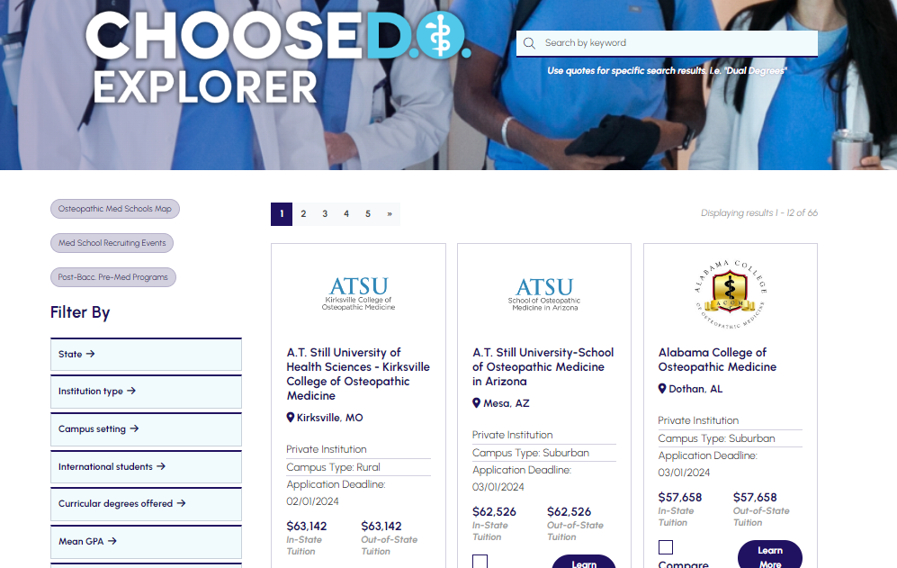
Choose DO Explorer
Notes:
Accessed from AACOM’s website under BECOME A DOCTOR Tab and Select explore medical schools.
https://choose.do/explorer/

Slide 27
  2022 Matriculant Profile
Mean MCAT Scores | Mean GPA
Psychological, Social & Bio – 127.2 | Science – 3.50
Bio & Biochemical – 126.3 | Non-Science – 3.68
Chemical & Physical – 125.9 | Overall GPA – 3.58
Critical Analysis & Reasoning – 125.1
Total MCAT – 504.5 | Data obtained from AACOM’s applicant and matriculant report
Notes:
2022 -23 applicant count = 23, 186
2022-23 applications submitted 212,038
I

Slide 28
Pulling Everything Together
Start filling out your AACOMAS Application
If eligible, apply for an AACOMAS fee waiver
Send to AACOMAS:
  Official transcripts of ALL colleges attended from registrar
  Official MCAT scores from AAMC
Submit your application and monitor your status
  Ensure receipt of official transcripts and letters of recommendation
  Ensure your application is complete and verified

Slide 29
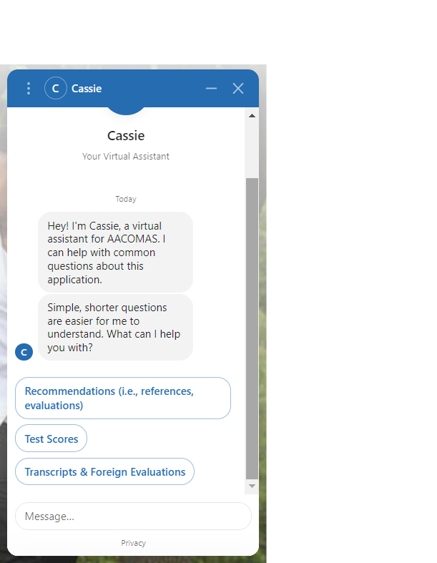
Contacting AACOMAS Customer Service
The Applicant Help Center is a fully-searchable resource that contains instructions for filling out each section of the application and sending in all required materials.
AACOMAS Customer Service is open Monday – Friday from 9 am – 5 pm ET
  Phone: 617-612-2889
  aacomasinfo@liaisoncas.com
  Cassie, the Virtual Assistant in AACOMAS

Slide 30
QUESTIONS?
Regina Bowman-Goldring
Director of Application Services, Recruitment and Student Affairs
rbowman-goldring@aacom.org

