Slide 1

Exploring Osteopathic Medicine
2025-2026 Cycle

Slide 2


Slide 3
Tenets of Osteopathic Medicine
The body is a unit; the person is a unit of body, mind, and spirit.
The body is capable of self-regulation, self-healing and health maintenance.
Structure and function are reciprocally interrelated.
Rational treatment is based upon an understanding of the basic principles of body unity, self-regulation and the interrelationship of structure and function.

Slide 4

Osteopathic Manipulative Medicine (OMM)

Slide 5
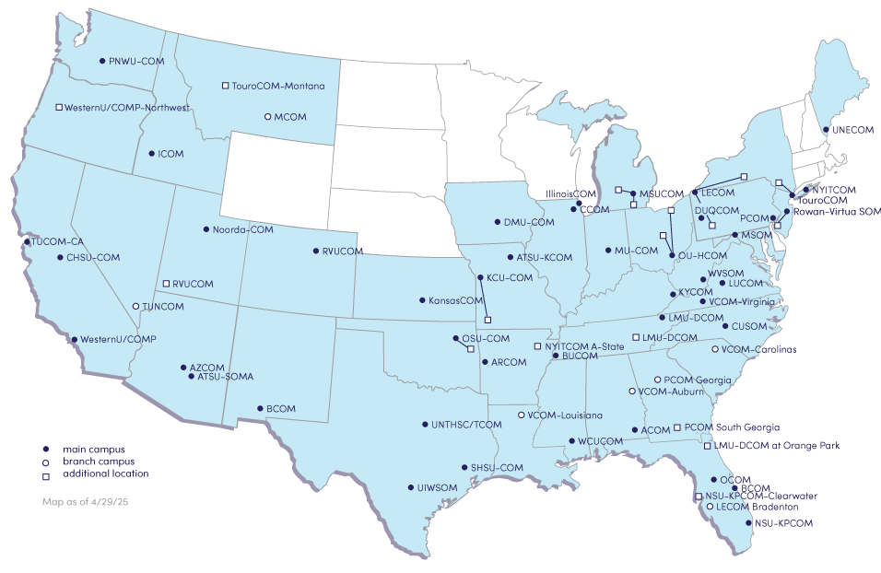

Slide 6


Slide 7
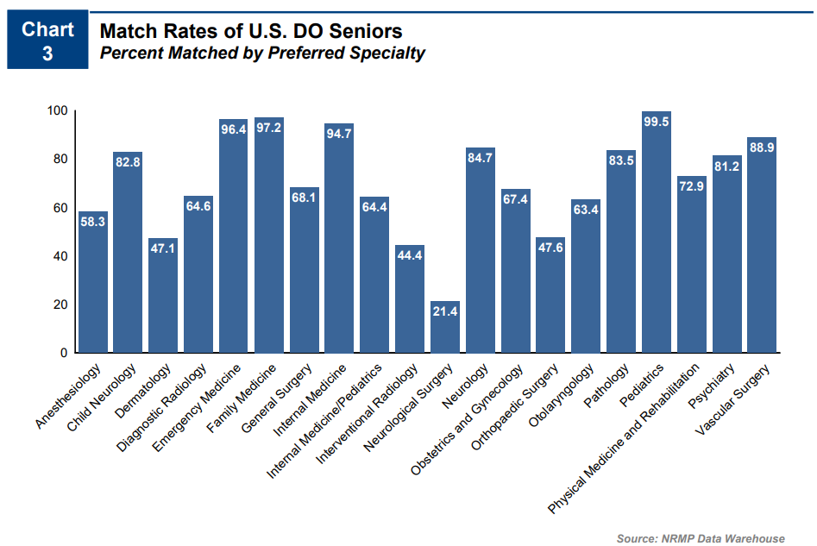
2024

Slide 8
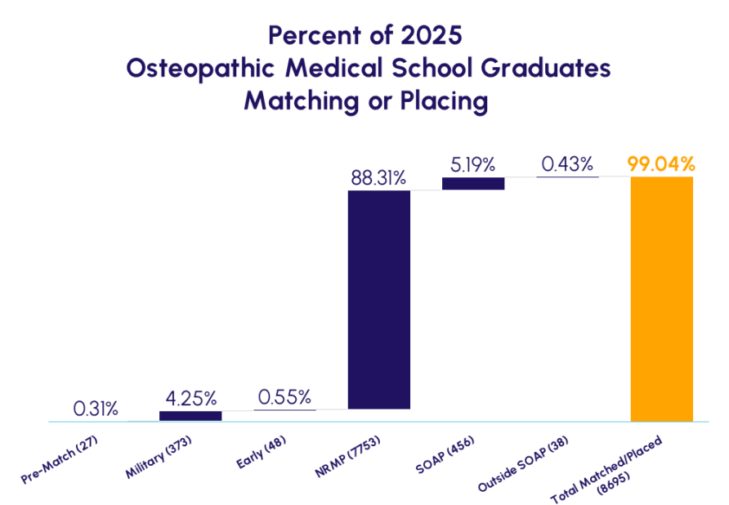

Slide 9
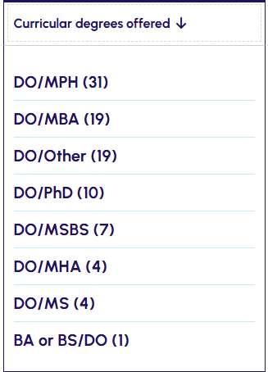
DUAL DEGREE OPPORTUNITIES
Many COMs offer students the opportunity to earn an additional degree in dual or concurrent degree programs. The programs listed here are among the most popular, but you can search all available options in the DO Explorer, available for free via the AACOM website at www.choosedo.org

Slide 10
Applying to Osteopathic Medical School

Slide 11
Admissions Requirements
Premedical coursework varies at each college but generally requires at least:
One year of biology
One year of physics
One year of English composition
Two years of chemistry
Competitive MCAT scores, science GPA, and overall GPA are also required.

Slide 12
  2024 Matriculant Profile
Mean MCAT Scores | Mean GPA
Psychological, Social & Bio – 126.8 | Science – 3.52
Bio & Biochemical – 125.78 | Non-Science – 3.71
Chemical & Physical – 125.41 | Overall GPA – 3.60
Critical Analysis & Reasoning – 124.99
Total MCAT – 502.97

Slide 13

Personal Qualities
Competitive applicants:
Demonstrate strong communication and interpersonal skills
Have a record of community service
Have a record of leadership
Have some clinical experience
Have participated in a variety of extracurricular activities
Come from diverse backgrounds
Possess knowledge of osteopathic medicine
Are interested in preventative care in addition to treatment of illness and injury

Slide 14
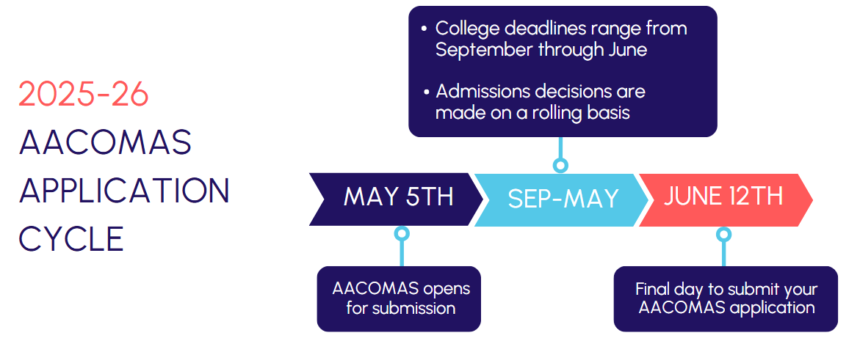

Slide 15
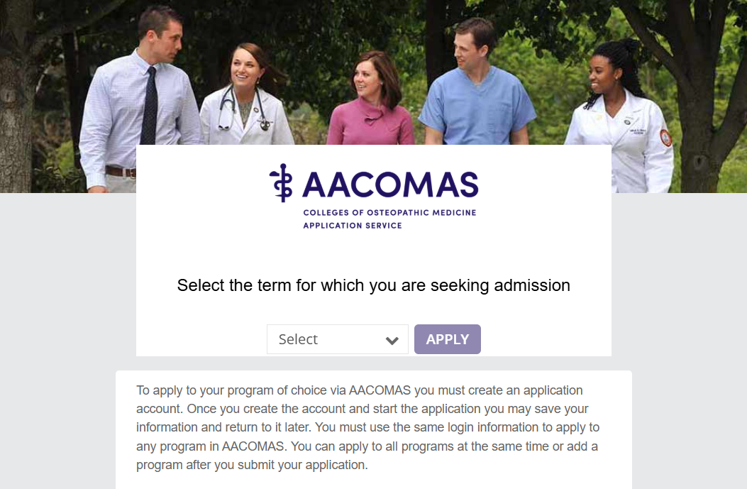
The Application

Slide 16
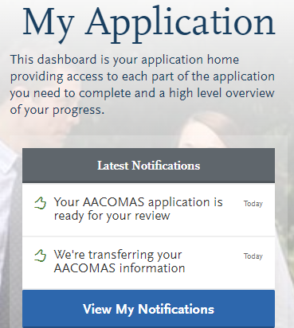

Application Overview – The 4 Quadrants

Slide 17
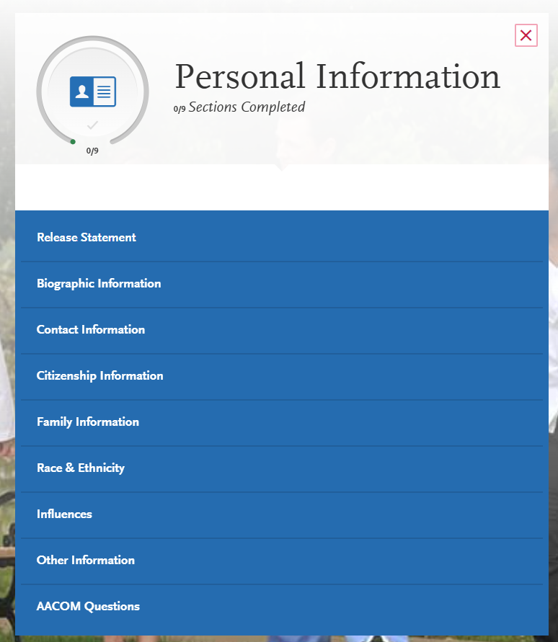

Slide 18


Slide 19


Sending Official Transcripts & MCAT Scores to AACOMAS
Transcripts must be sent to AACOMAS from all US and English-speaking Canadian institutions you listed in the Colleges Attended section of your application, even if the courses later transferred to another institution.
Do not send foreign transcripts (non-US/non-English-Canadian). This includes transcripts from Caribbean and French-Canadian schools.
You must request that AAMC release your MCAT scores to AACOMAS. After AAMC processing, scores are sent to AACOMAS in batches and then posted to applications daily. You can view scores attached to your application in the Standardized Tests section of the Check Status tab.

Slide 20
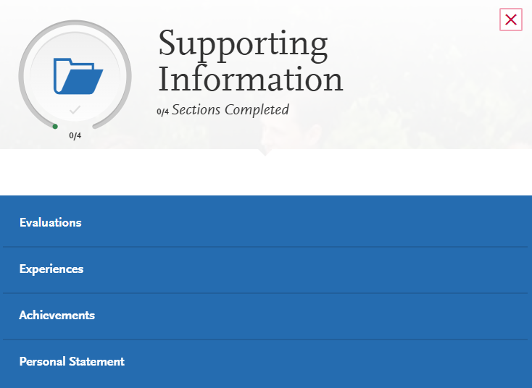

Slide 21
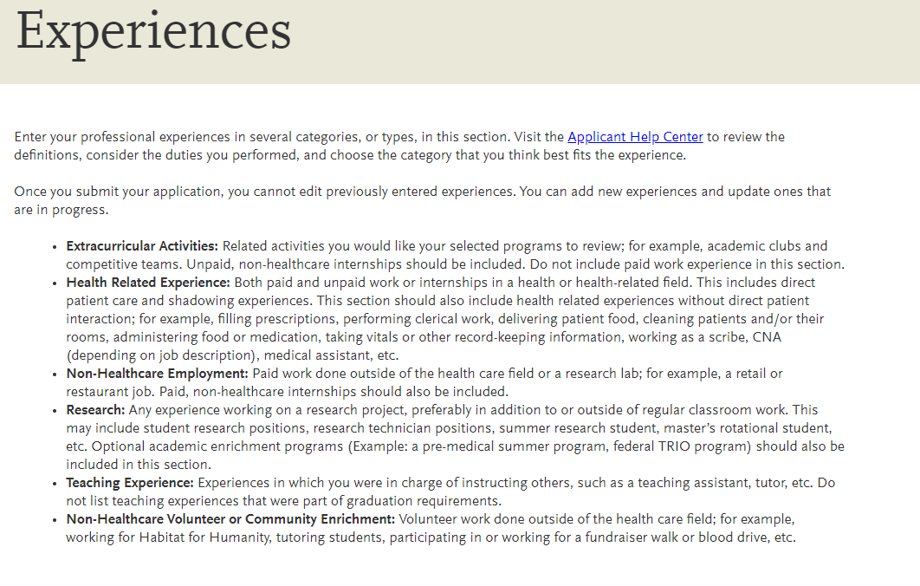

Slide 22
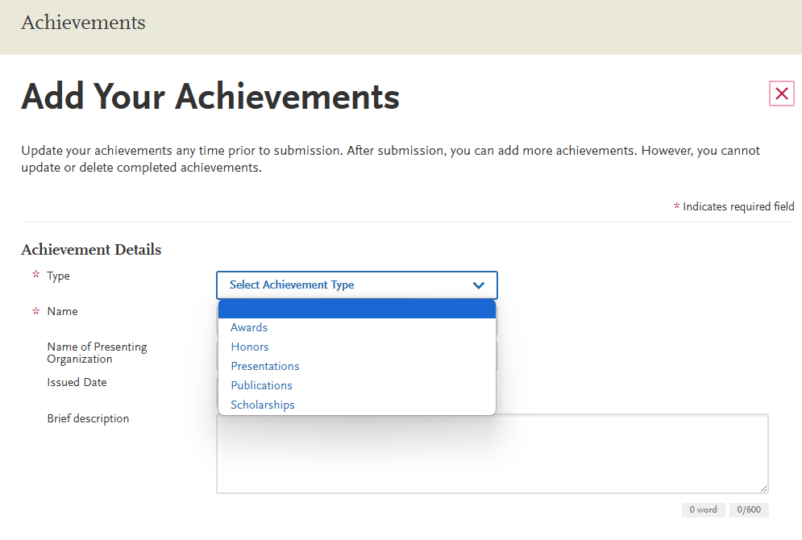

Slide 23
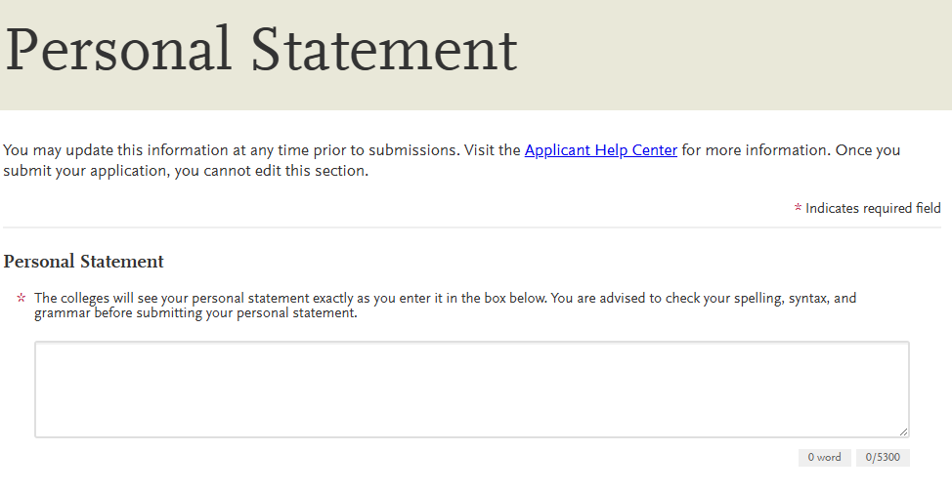

Slide 24

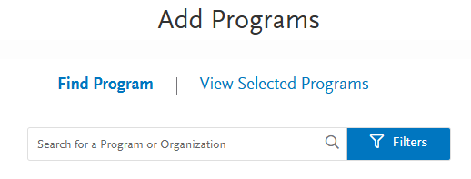
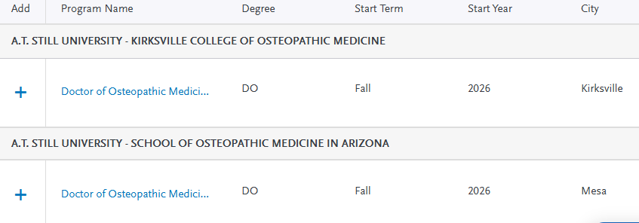

Slide 25
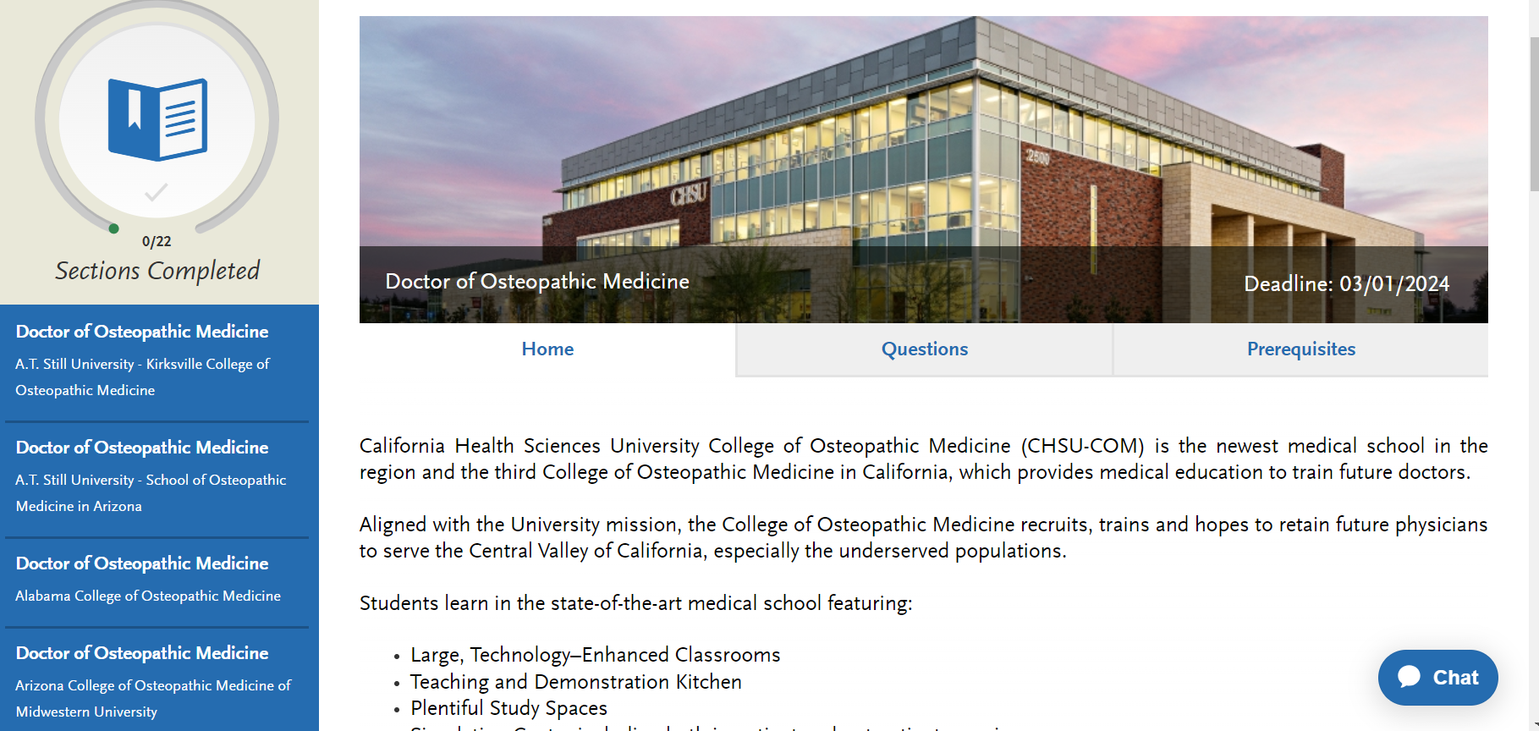
Program Page

Slide 26
What Does it Cost to Apply?
Primary Application fee = $198
Additional Designation = $60
AACOMAS Fee Waiver Program covers the initial application fee only for eligible applicants.
    Qualified applicants may be considered for additional waivers at the COM’s discretion

Slide 27
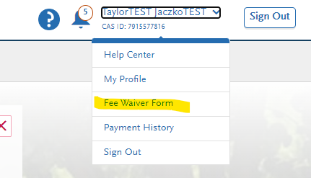
Fee Waiver Program
Fee waiver application is embedded in AACOMAS
Waiver must be requested and decided on BEFORE the AACOMAS application is submitted
If approved, the AACOMAS application MUST be submitted within 14 days or the waiver will be forfeited
Colleges may waive their secondary application fees for students who receive an AACOMAS fee waiver

Slide 28
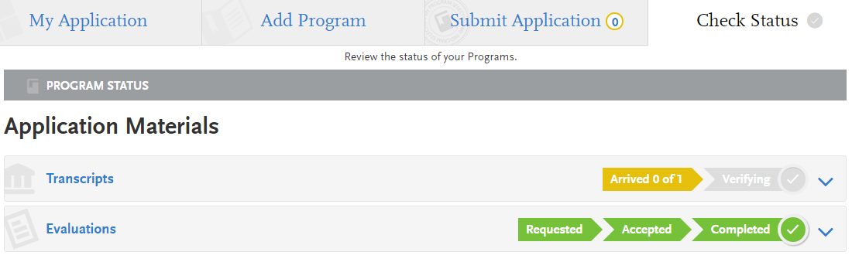
Submitting and Monitoring Your Application
In Progress
Received / Incomplete
Complete
Verified

Slide 29
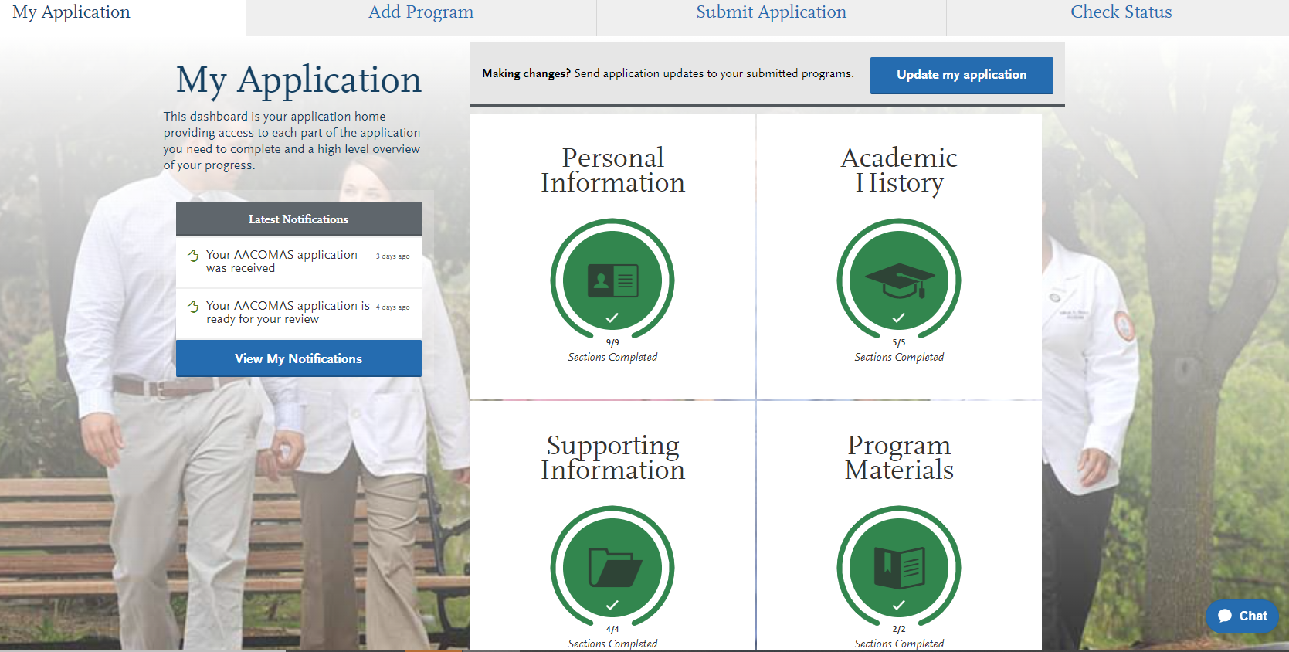
Checking the status of an application

Slide 30
Limited Post-Submission Edits
Once you submit your application, most sections are locked to prevent edits. Updates you can make include:
Editing your contact information.
Editing your profile information (username, password, etc.).
Modifying your release statements
Adding programs with deadlines that have not yet passed.
Adding new evaluations (if you have not yet requested the maximum number of evaluations).
Editing or deleting evaluations that remain incomplete.
Adding new entries to certain areas of the Academic History, Supporting Information, and Program Materials sections (e.g., test scores, experiences, optional documents, etc.), where applicable (you are unable to edit or delete existing entries).
Editing In-Progress Experiences.
Editing program materials for programs you have not yet submitted to.
Adding optional documents to programs that you already submitted to (all other sections will be locked).

Slide 31
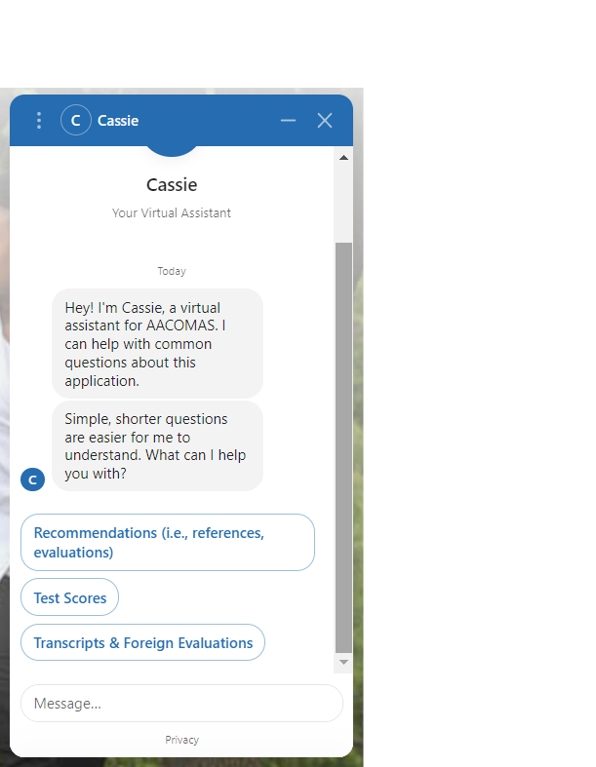
ACOMAS Customer Service
The Applicant Help Center is a fully-searchable resource that contains instructions for filling out each section of the application and sending in all required materials.
AACOMAS Customer Service is open Monday – Friday from 9 am – 5 pm ET
  Phone: 617-612-2889
  aacomasinfo@liaisoncas.com
  Cassie, the Virtual Assistant in AACOMAS

Slide 32

Questions?
The DO Explorer
Regina Bowman-Goldring
Director of Application Services, Recruitment and Student Affairs
RBowman-Goldring@aacom.org
Briana O’Neal
Manager of Application Services and Outreach
boneal@aacom.org

