Slide 1



Defining and Aligning Foundational Competencies for UME: Introducing A New Competency Initiative
Discussion forum
August - December 2022
Notes:
Lisa

Slide 2
Welcome to the Discussion Forum!
Agenda
    3:00 Welcome, Project Aim, Goals and Timeline
    3:25 Breakout Discussion
    4:00 Closing
A Few Details…
Please stay muted while not speaking
The focus of this forum will be to discuss specific questions about the development of new foundational competencies in medical education
Due to the size of our group, we may not have time to answer all of your questions. However, we invite you to submit your questions and comments to CBME@aamc.org
We will be recording the main room (and not breakout rooms) of this forum

Slide 3
Project Aim
Through an inclusive and iterative process, we will create a common set of national foundational competencies for use in undergraduate medical education programs in the U.S. that align horizontally among UME programs and vertically across the continuum of medical education.
Sponsors: The Association of American Medical Colleges, The American Association of Colleges of Osteopathic Medicine, and the Accreditation Council for Graduate Medical Education
Notes:
Mark

Slide 4
Goal Statement
The goal of this project is to create a common set of national foundational competencies for use in undergraduate medical education programs in the U.S. that align horizontally among UME programs and vertically across the continuum of medical education.
Currently, competency frameworks from UME, GME and CPD are fragmented. The language of CBME is not shared from one phase of the continuum to the next and this results in many challenges and suboptimal transitions from UME, GME and into practice.
The set of foundational competencies will be based upon the six core competency domains or framework initially developed in 1999 and widely endorsed in 2014. The foundational competencies and sub competencies in these 6 areas will be intended to support formative professional development including the transition from UME-GME.

Slide 5
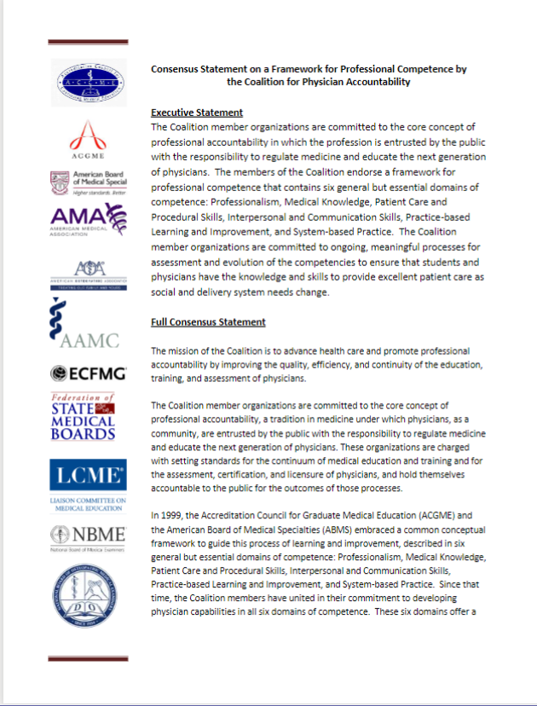
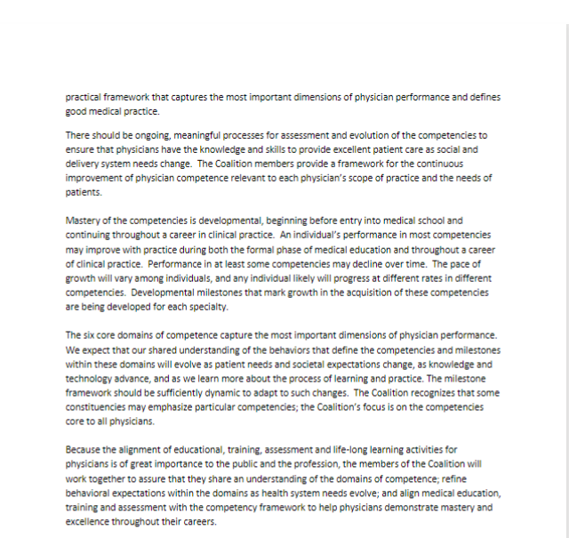
Cross-Continuum Consensus on Core Competencies, 2014
The Coalition for Physician Accountability endorses the “framework for professional competencies that contain six general but essential domains of competence.”
Notes:
ERIC
In 2014, the Coalition for Physician Accountability released this join statement on CBME in medical education endorsing the “framework for professional competencies that contain six general but essential domains of competence.”
Executive Statement: The Coalition member organizations are committed to the core concept of professional accountability in which the profession is entrusted by the public with the responsibility to regulate medicine and educate the next generation of physicians. The members of the Coalition endorse a framework for professional competence that contains six general but essential domains of competence: Professionalism, Medical Knowledge, Patient Care and Procedural Skills, Interpersonal and Communication Skills, Practice-based Learning and Improvement, and System-based Practice. The Coalition member organizations are committed to ongoing, meaningful processes for assessment and evolution of the competencies to ensure that students and physicians have the knowledge and skills to provide excellent patient care as social and delivery system needs change.

Slide 6



Core Competency Domains, 1999
Patient Care and Procedural Skills
Interpersonal and Communication Skills
Medical Knowledge
Practice-based Learning and Improvement
Professionalism
Systems-based Practices
Notes:
Core Competency Domains: The six domains of educational and clinical knowledge, skills, and attitudes that physicians must develop for independent and autonomous practice of a specialty or subspecialty. These domains are: Patient Care and Procedural Care; Medical Knowledge; Practice-based Learning and Improvement; Interpersonal and Communication Skills; Professionalism; and Systems-based Practice.
Patient Care that is compassionate, appropriate, and effective for the treatment of health problems and the promotion of health
Medical Knowledge about established and evolving biomedical, clinical, and cognate (e.g., epidemiological and social-behavioral) sciences and the application of this knowledge to patient care
Practice-Based Learning and Improvement that involves investigation and evaluation of their own patient care, appraisal and assimilation of scientific evidence, and improvements in patient care
Interpersonal and Communication Skills that result in effective information exchange and teaming with patients, their families, and other health professionals
Professionalism, as manifested through a commitment to carrying out professional responsibilities, adherence to ethical principles, and sensitivity to a diverse patient population
Systems-Based Practice, as manifested by actions that demonstrate an awareness of and responsiveness to the larger context and system of health care and the ability to effectively call on system resources to provide care that is of optimal value.

Slide 7


Competencies Across the Continuum:
Foundational (UME) Competencies for Our Shared Framework
ABMS 6 Core Competencies Integrated within Continuing Certification
Pre-Med Competencies
Foundational Competencies
Transition to Residency Competencies
GME 6 Core Competencies & Their Milestones
Secondary Focus
(Specialty societies lead post-match transition to GME needs; Build from foundational competencies and align with GME Milestones)
Primary Focus
Relevant Parallel Focus
(AAMC Core competencies for entering medical students are being refreshed thru June 2023 and will inform the UME Foundational Competencies)
Notes:
Green is focus of this project and will inform TTR
The primary and initial focus of this project will be on the foundational competencies at the early stages of medical education. These competencies will be aligned with the GME core competencies (same framework 6 core competency domains and informed by GME milestones), and we will work with the specialty societies to consider those areas that need additional focus for each specialty during the transition to residency phase (post match or specialty decision and early internship/PGY1). For example, we will have foundational competencies that are relevant to ALL physicians regardless of specialty that will be developed and assessed throughout UME. The largest specialties (FM, IM, EM, GS, Peds, Psych, OBGYN, Neuro) will have additional areas for focus in regard to the transition to residency. These already take the form of variable boot camps or TTR courses at the UME or GME level. Once we have foundational competencies, those curricula would ideally be designed or tailored to build upon the foundational competencies. In reality, these may not be done in sequential order and will need to work collaboratively to consider how the specialty comps inform the foundational comps.
What does a competent graduate of medical schools be able to do, know, and value regardless of specialty of practice?

Slide 8
Project Phases: 1-4
COLLABORATIVE PLANNING
September 2021 -
July 2022
1
COMMUNITY DISCUSSIONS AND LANDSCAPE REVIEW August 2022 - December 2022
2
DEVELOPMENT
December 2022 - November 2023
3
DISSEMINATION
December 2023 +
4
Notes:
LYNNE
The overall project is divided into four phases -
The first collaborative planning includes ID and invitation of key stakeholders in the work and clarification of their roles and contributions.
The 2nd phase is intended to understand the landscape of practicing medicine in this century and in competency-based education in UME, GME and CPD. Specifically to ID the major trends facing health care today and CBE frameworks that are being used at the various stages of physician training and development. What does it mean to be a physician and what are unique characteristics? This phase also includes multiple listening sessions to stakeholders who can attest to how health care is changing, how CBE is operationalized at the local institution or program. What is their level of understanding? What are resources? What are barriers and opportunities in CBE? Who are the active organizations in CBE or who have a key stake in advancing CBE across the continuum?
The third phase will focus on the initial development of foundational competencies. A working group of the larger advisory committee will work to draft an initial set of competencies based on the six domains of competence. This initial draft will be shared initially with the collaborators for feedback, revisioning and posted for public comment. This feedback will be collected, analyzed and used to inform revisions for the release of foundational competencies version 1.0. This version will be shared broadly and future actions for their integration will be determined with the advisors and collaborators engaged in this project. In addition, a revision cycle will be agreed upon and made public upon release.

Slide 9
Phase 1: Collaborative Planning
(September 2021 – July 2022)
Products
Key Task 2
Key Task 3
Roster of Advisory Committee members, project charge and timeline
Identify Advisors & Collaborators
Creation of Advisory Committee & Collaborative Work Plan
Partnership MOU
KEy Task 1
Recruitment of Project Team
KEY TASK 4
Draft Project Goals, Principles, FAQs
Draft Project Goals, Principles, FAQs

Slide 10
Advisory Committee*
20+ member committee has been developed to advise the core team on various project details and share their unique and important perspectives. Members include representatives from many organizations and groups, including:
Alliance for Clinical Education
American Medical Association
American Osteopathic Association
Educational Commission on Foreign Medical Graduates
International Association of Medical Science Educators
National Board of Medical Examiners
National Board of Osteopathic Medical Examiners
Organization of Program Director Associations
Transition to Residency Course Educators Collaborative
Directors of Clinical Skills Courses
Group on Educational Affairs¹
Group on Educ Affairs CLASS Project¹
Medical Education Sr Leaders¹
Group on Diversity and Inclusion¹
Group on Resident Affairs¹
Council of Faculty & Specialty Societies¹
Society of Osteopathic Medical Educators²
Group of Clinical Deans²
Council of Osteopathic Student Govt Presidents²
*Reflects those that are confirmed 8.12.22. 1-AAMC group or council; 2-AACOM group or council

Slide 11
Phase 2: Community Discussions and Landscape Review (August – December 2022)
Products
Key Task 2
Key Task 3
Work plan
Convene Advisory Committee
Discussion forum to collect comments, reactions, questions, and guidance
Key Task 1*
Creation of reference collection
Collaborator focus sessions
Reference collection to support the development process
Protocol for listening sessions
Identify Working Group Members

Slide 12
Phase 3: Development (~December 2022 – November 2023)
Product
New Foundational Competencies
Key Task 1
Collect iterative feedback on draft competencies from collaborators and other stakeholders
Develop final set of competencies for all domains
Key Task 3
Key Task 2
Initially draft competencies for all domains

Slide 13
Working Group
  12–15-member group will be formed in late 2022 to work throughout 2023
  This group will follow a facilitated iterative process to draft new foundational competencies for undergraduate medical education
  These members will be invited through an open call to participate.
  Applicants will be reviewed for expertise in education and curriculum development, diversity in region, type of institution, and more. The request for applicants (RFA) will be posted in fall 2022.

Slide 14
Step 4: Dissemination (~December 2023+)
Product
Key Task 1
Key Task 3
Final Foundational Competencies & their Digital Home
Develop and implement communication plan
Track ongoing metrics & feedback of competencies
Refresh digital communications incl reports, pdfs, visuals
KEY TASK 2
Identify all communications related to CBME and refresh to reflect new foundational competencies and current evidence

Slide 15
We look forward to hearing from you!
A facilitator has been preidentified for each breakout room
Identify one additional person to volunteer as a recorder
If you volunteer to be recorder: open a new email message, address it to cbme@aamc.org, note the room #, record your notes and, at end of session, hit send.
Between 12-16 people per breakout, ~30 minutes
Be on camera, if possible
The breakout discussion will NOT be recorded, but recorder notes will be collected for use by the project team
Please do brief introductions: Name, Title, Institution
We want to hear from ALL participants during the breakout session – please limit length of responses to allow for many to share
You will NOT be returned to the main session and will depart from the breakout room
In just a moment, we will introduce several questions for discussion. We will also post in the chat so you can copy them and paste in the breakout room chat.
Thank you for joining us and for sharing your questions and your expertise!
Notes:
MARK

Slide 16
Discussion Questions
For those working directly in medical education (teaching, designing curriculum or assessment methods), what frameworks for competency-based education (CBE) are currently being used? What does "use" mean at the local school level?
What will we expect all future physicians (or medical students) be able to do, know and value regardless of their specialty in the six domains of competence (medical knowledge, patient care, systems-based practice, practice-based learning and improvement, professionalism and interpersonal and communication)?
What questions or concerns does this project raise for you?
Notes:
(Optional) What are implications to adopting a common set of competencies across undergraduate medical education (UME) that align with graduate medical education (GME)?

