Slide 1
Awards & Recognitions

Slide 2
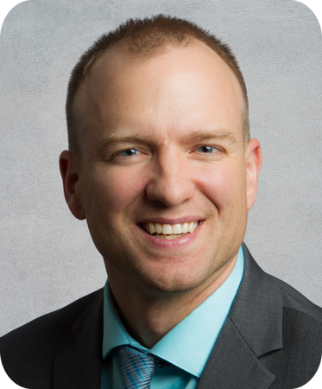
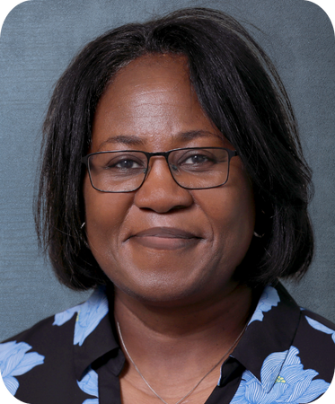
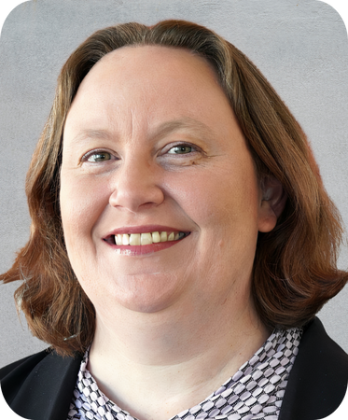
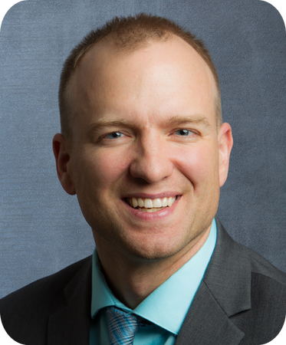
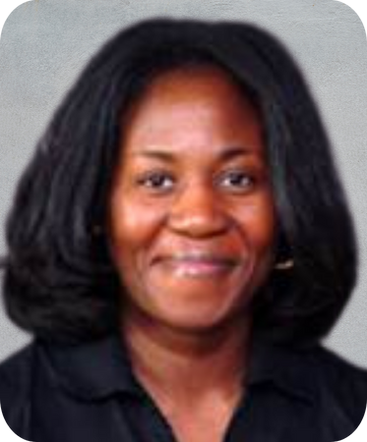
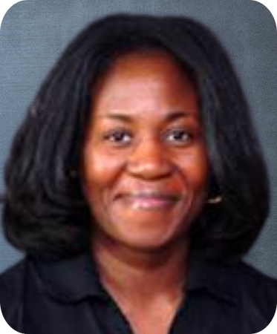
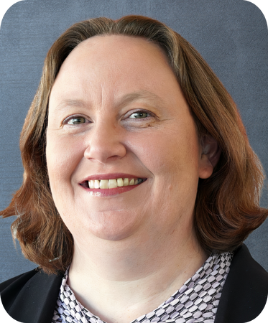

New NAOME Fellows
Jacob Allgood, DO
A.T. Still University - School of Osteopathic Medicine in Arizona
Teaching and Evaluation
Maria Barnes, PhD, MS
Des Moines University College of Osteopathic Medicine
Teaching and Evaluation
Jennifer Hotzman, PhD
Idaho College of Osteopathic Medicine
Teaching and Evaluation

Slide 3
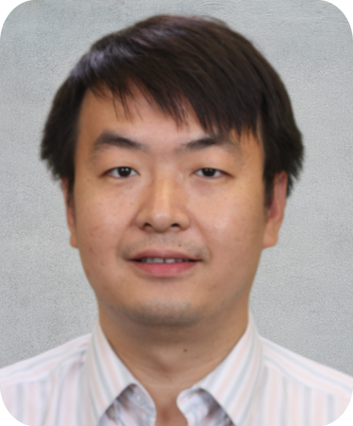
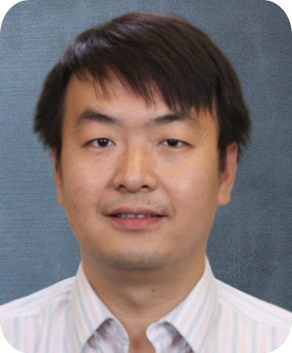
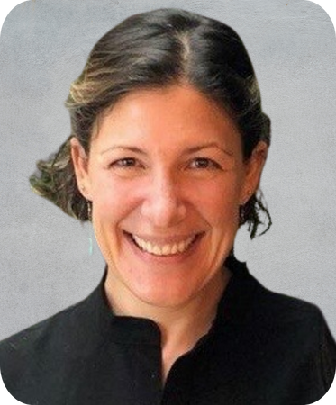
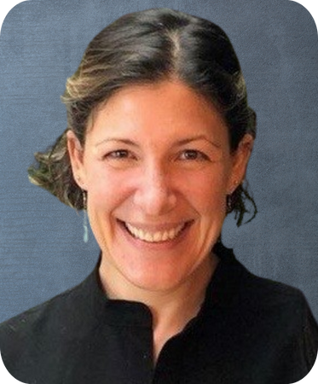
New NAOME Fellows
Tuoen Liu, MD, PhD
West Virginia School of Osteopathic Medicine
Teaching and Evaluation
Edith Sperling, DPT, PhD
Western University of Health Sciences College of Osteopathic Medicine of the Pacific
Educational Research

Slide 4
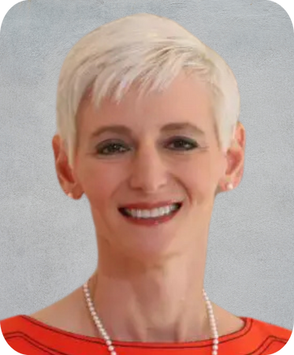
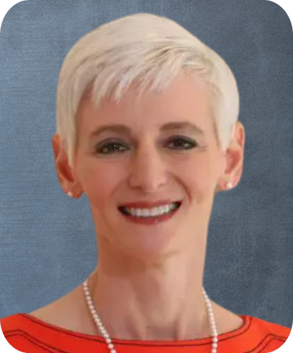
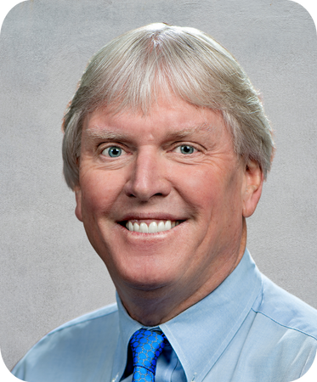
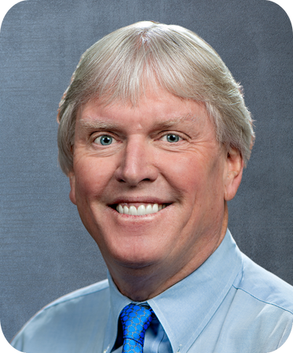
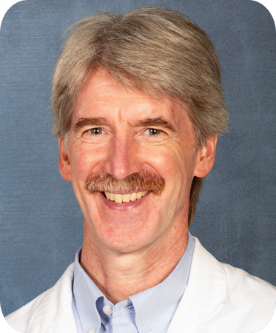
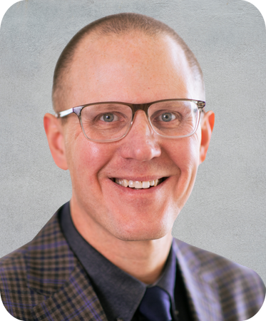
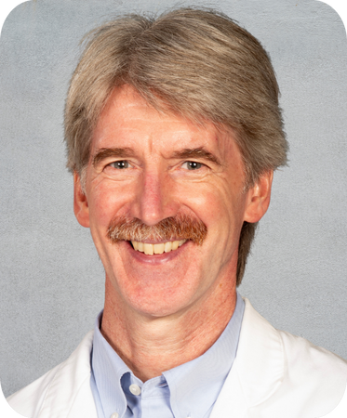
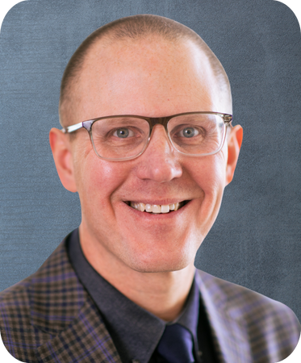
Renewed NAOME Fellows
Natasha Bray, DO
Oklahoma State University Center for Health Sciences College of Osteopathic Medicine – Tahlequah
Educational Leadership
(2020-2025; 2025-2030)
Charles Finch, DO
Arizona College of Osteopathic Medicine of Midwestern University
Educational Leadership
(2020-2025; 2025-2030)
David Fuller, DO
Philadelphia College of Osteopathic Medicine
Teaching Evaluation
(2020-2025; 2025-2030)
Matthew Henry, PhD
Des Moines University - College of Osteopathic Medicine
Teaching and Evaluation
(2010-2015; 2015-2020; 2020-2025; 2025-2030)

Slide 5
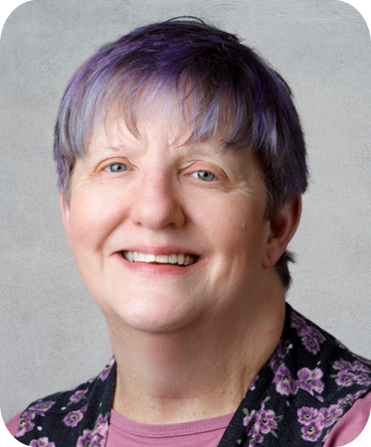
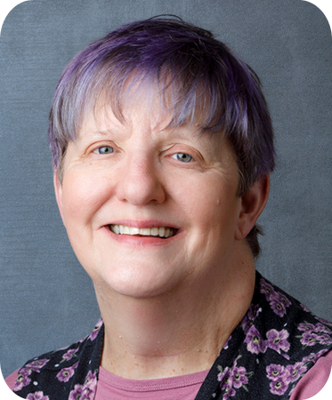
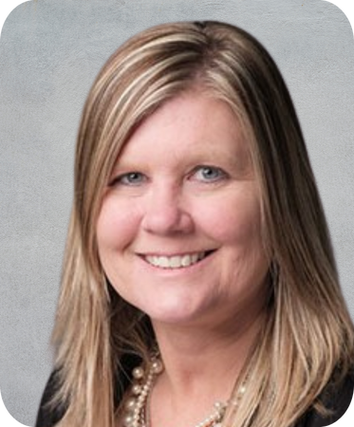
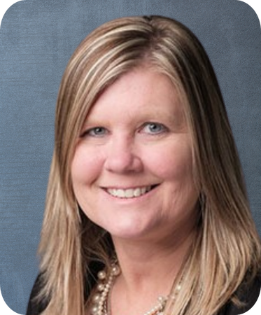
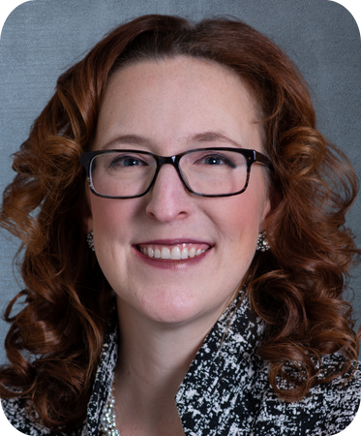
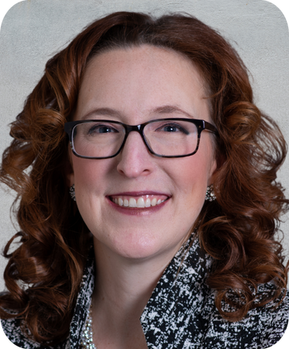
Renewed NAOME Fellows
Diane Karius, PhD
Kansas Health Science University - Kansas College of Osteopathic Medicine
Teaching and Evaluation
(2010-2015; 2015-2020; 2020-2025; 2025-2030)
Machelle Linsenmeyer, EdD
West Virginia School of Osteopathic Medicine
Educational Leadership
(2015-2020; 2020-2025; 2025-2030)
Stacey Pierce-Talsma, DO, MS
University of New England College of Osteopathic Medicine
Educational Leadership
(2015-2020; 2020-2025; 2025-2030)

