Slide 1
The National Academy of Osteopathic Medical Educators (NAOME) is a community of outstanding osteopathic educators who have met rigorous standards of academic excellence to earn the designation of fellow.
Copyright © 2019 American Association of Colleges of Osteopathic Medicine. All Rights Reserved.
Photo courtesy of Marian University College of Osteopathic Medicine (MU-COM).

Slide 2
NAOME Serves the Osteopathic Profession
Fosters scholarship in teaching and learning
Provides role modeling and support for medical educators
Promotes networking and collaboration among institutions
Functions as a “think tank” by providing a forum for innovation and an exchange of ideas

Slide 3
Who should apply?
Mid-career faculty seeking opportunities to “pay it forward” and serve as a leader in osteopathic medical education
Requirements
Five or more years of academic experience
Demonstrated commitment to osteopathic medical education
Evidence of scholarship in one of four areas:
Teaching and Evaluation
Educational Research
Educational Leadership
Development of Durable Educational Materials

Slide 4
What scholarship category is a fit for you?
Teaching and Evaluation | Educational Leadership
You mostly teach and/or work with curriculum You teach in a clinical settings, labs or online You have tangible outcomes | You mostly hold significant leadership roles in courses, curriculum development, education-related grants or administrative duties You plan and execute school-wide committees, educational programs, curricular initiatives, and policy development You have mentored others
Educational Research | Development of Durable Educational Materials
You mostly perform research Your research is on medical education You have been published and/or presented nationally | You mostly prepare educational materials You have presented the material at a regional or national conference Your work has been evaluated, peer-reviewed, and/or demonstrated to be useful

Slide 5
Opportunities for Engagement
Provide Mentorship
Academy applicants in developing a mini-portfolio
Educators submitting AACOM conference abstracts
Applicants for AACOM Medical Education Research grants
Collaborate with Others
Development of an innovative medical education or research projects
Joint conference presentations
Participate in bi-annual fellow meetings
Network and share resources through NAOME and SOME online communities
Serve as a Reviewer
Abstract submissions
Research presentations
Medical education research grant submissions
JAOA Medical Education manuscripts
Fellowship Applications
Be a leader
Committee chairs
New initiatives

Slide 6
Fellow Voices
“Becoming a Fellow of NAOME was a rare honor as I was welcomed to join a collegial and well accomplished cohort of others with like minds and passions.” Mark Andrews, PhD, FNAOME 2012
“Participation in this national organization allows me to contribute broadly to medical education while also learning from other fellows, students, and osteopathic programs.”
Matt Henry, PhD, FNAOME 2010
“Learning from each other strengthens us all. True leaders don’t have (or need) followers, their biggest impact is really to encourage and develop others to lead.”
John Graneto, DO, Med, FNAOME 2011
“I believe what has been developed has potential to provide mentoring and development, as well as recognition for faculty, and better educational practices for facilitating student learning. Ultimately this will translate into better care for patients.”
Patricia Sexton, DHED, founding Chair, FNAOME 2009

Slide 7
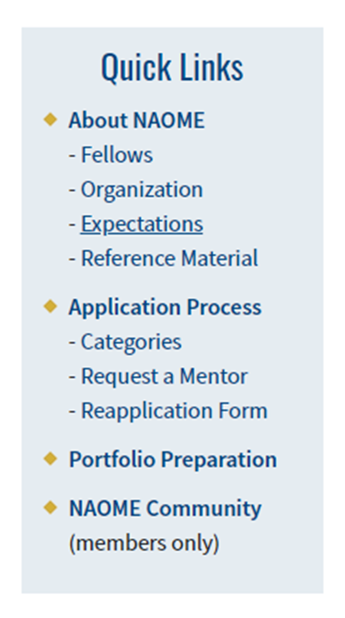
How to get started
Review the NAOME website for standards and service expectation of NAOME fellows.
Identify what NAOME scholarship category is right for you
Begin collecting evidence of your scholarship and updating your CV
When you are ready to begin your application seek support

Slide 8
Seek the support of your leadership and complete the reference check form

Slide 9
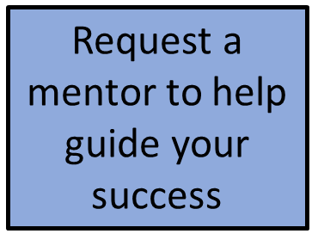
Request a Mentor

Slide 10
Timeline
Applications open: August/September
Application deadline: December/January
Review process: January
Fellow Notifications: February
Fellows Inducted: AACOM Annual Conference (March/April)

Slide 11
We look forward to welcoming you!

Slide 12
Developed by NAOME Leadership Produced by Rowan University School of Osteopathic Medicine August 2020
For more information, please visit the NAOME website
https://www.aacom.org/ome/aacom-councils-and-groups/national-academy-of-osteopathic-medical-educators-(naome)

