Slide 1
Dermatology

Slide 2
Dermatology Overview
A dermatologist specializes in the medical and surgical treatment of conditions related to the skin, hair, nails, and mucous membranes. This encompasses a broad range of disorders including infectious, immunologic, degenerative, neoplastic (relating to the growth of tumors), and oncologic (cancer-related) diseases. Their expertise extends to diagnosing and managing complex skin conditions and diseases
Dermatologists treat a broad range of diseases, from life-threatening skin cancers and drug reactions to life-disrupting conditions such as eczema, psoriasis and acne, as well as changes associated with aging.
During their training, dermatologists will learn to recognize and diagnose skin diseases in adults and children, how to biopsy and interpret the microscopic presentation of skin disease, and how to surgically and medically manage and treat these conditions.
Sources
American Board of Medical Specialties (Last accessed 2024)
https://www.abms.org/board/american-board-of-dermatology/#abd-d
American Board of Dermatology (Last accessed 2024) ​
https://www.abderm.org/public/what-is-a-dermatologist

Slide 3
Dermatology Subspecialties
Dermatopathology
Micrographic Surgery & Dermatologic Oncology
Pediatric Dermatology
Source​
Accreditation Council for Graduate Medical Education (ACGME)

Slide 4
Dermatology Data Overview​ Data Overview​
Number of Accredited Residency Programs (2024)¹ | 143
Percentage of Programs Often Interviewing DOs (2024)² | 18%
Typical Length of Residency Training | 4 Years
Preliminary Year Required | Yes*
Mean COMLEX Level 2 CE Score (2024)³ | 612
Mean USMLE Step 2 Score (2024)³ | 250
Program Signals (2023/2024 Application Cycle)⁴ | 28
Mean Research Experience (2024)³ | 4.5
Mean Publications, Presentations (2024)³ | 15.4
Mean Number of Work Experiences (2024)³ | 2.6
Mean Number of Volunteer Experiences (2024)³ | 6.0
Average Hours Worked Per Week⁵ | 61
Median Salary⁵ | $399,000
Sources​
Accreditation Council for Graduate Medical Education (ACGME)​
Results of the 2024 NRMP Program Director Survey​
Charting Outcomes in the Match: Senior Students of U.S. DO Medical Schools​
ERAS Application and Program Signaling for 2024-2025
Careers in Medicine​
Note​
*Some dermatology programs require a preliminary year (advanced programs), while others do not (categorical programs).

Slide 5
Top Factors Considered by Program Directors for Choosing Interviewees​
Letters of recommendation in the specialty (100%)
Receipt of preference (program) signal (91%)
Personal Statement (91%)
Personal prior knowledge of the applicant (82%)
USMLE Step 1 pass (82%)
MSPE/Dean’s Letter (82%)
Grades in required clerkships (82%)
USMLE Step 2 CK score (73%)
Class ranking/quartile (73%)
Perceived commitment to specialty (64%)
Other life experience (64%)
History of having overcome significant obstacles (64%)
Grades in clerkship in desired specialty (64%)
Any failed attempt in USMLE (64%)
Alpha Omega Alpha (AOA) membership (64%)
Evidence of professionalism and ethics (64%)
Passing USMLE Step 2 CS (55%)
Leadership qualities (55%)
Gold Humanism Honor Society membership (55%)
Diversity characteristics (55%)
Consistency of grades (55%)
Awards or honors in clerkship in desired specialty (55%)
Audition elective/rotation at the program (55%)
Geographic preferences (55%)
Source​
Results of the 2024 NRMP Program Director Survey

Slide 6
COMLEX Level 2 CE Score Ranges (2024)​
Source​: Charting Outcomes in the Match: Senior Students of U.S. DO Medical Schools 2024

Slide 7
USMLE Step 2 CK Score Ranges (2024)​
Source​: Charting Outcomes in the Match: Senior Students of U.S. DO Medical Schools 2024

Slide 8
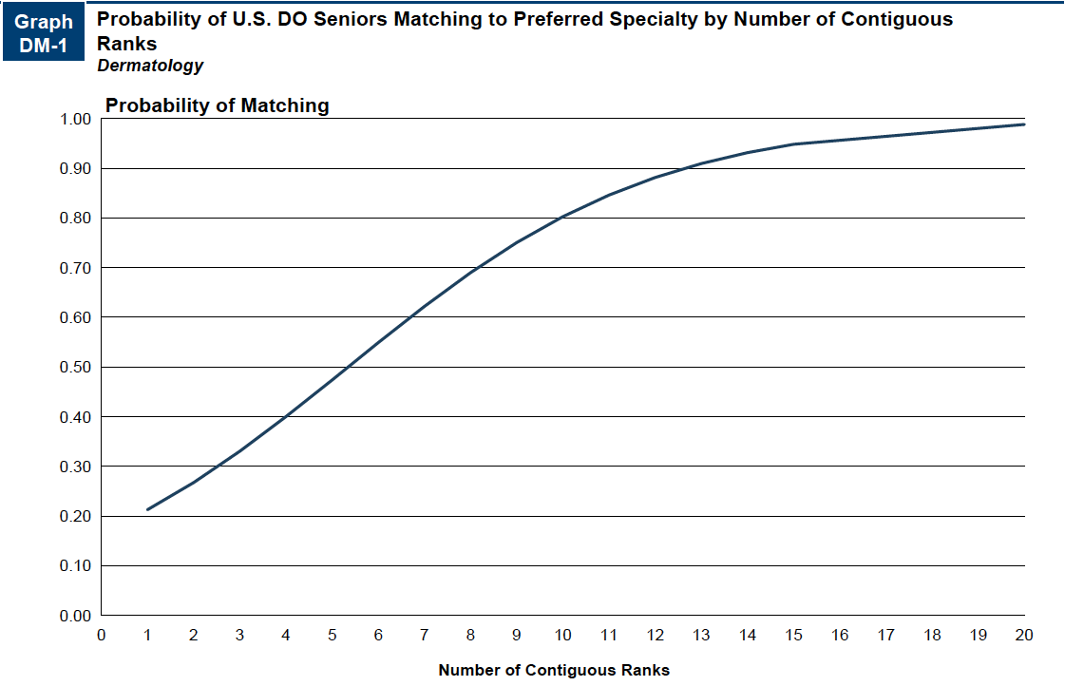
Probability of Matching Based on Number of Programs Ranked​
Source​: Charting Outcomes in the Match: Senior Students of U.S. DO Medical Schools 2024

Slide 9
Dermatology Resources
Careers in Medicine Website
American Osteopathic College of Dermatology
American Academy of Dermatology
  Meetings and Education
Mentorship Opportunities
  American Academy of Dermatology (ACA)

