Slide 1
Emergency Medicine

Slide 2
Emergency Medicine Overview
Emergency medicine (EM) involves the immediate care of urgent and life-threatening conditions found in the critically ill and injured. These physicians are really specialists in breadth–their broad-based training encompasses acute problems that span several clinical disciplines.
No other specialty can match the astounding variety of patients found in the emergency room. You will see, hear and smell things that most doctors will not. In just one shift, an emergency physician may care for patients presenting with asthma attacks, atrial fibrillation, gunshot wounds, dislocated shoulders and even cockroaches stuck in their ears.

Slide 3
Emergency Medicine Cont'd
Every now and then, the EM doctor will discover a zebra, such as a pheochromocytoma (adrenal gland tumor) in a young woman with high blood pressure and headaches. EM has only been a specialty for about 25 years. Prior to that, most doctors who covered acute, emergent and traumatic illnesses were board-certified in other fields, usually internal medicine or surgery.
Fast-paced and unpredictable, emergency medicine is one of the newest specialties in medicine. It has grown to meet the challenge of 100 million emergency room visits per year.
Source ​
Miller, A. J. (2019). Anesthesiology In B. S. Freeman (Ed.), The ultimate guide to choosing a medical specialty (4 ed., pp 198-199). New York: McGraw Hill. ​

Slide 4
Emergency Medicine Subspecialties
Emergency Medical Services
Medical Toxicology
Pediatric Emergency Medicine
Sports Medicine
Undersea & Hyperbaric Medicine
Source​
Accreditation Council for Graduate Medical Education (ACGME)

Slide 5
Emergency Medicine Data Overview​
Number of Accredited Residency Programs (2024)¹ | 282
Percentage of Programs Often Interviewing DOs (2024)² | 88%
Typical Length of Residency Training | 3 Years
Preliminary Year Required | No
Mean COMLEX Level 2 CE Score (2024)³ | 538
Mean USMLE Step 2 Score (2024)³ | 242
Program Signals (2024/2025 Application Cycle)⁴ | 5
Mean Research Experience (2024)³ | 1.8
Mean Publications, Presentations (2024)³ | 2.9
Mean Number of Work Experiences (2024)³ | 2.7
Mean Number of Volunteer Experiences (2024)³ | 4.2
Average Hours Worked Per Week⁵ | 46.4
Median Salary⁵ | $332,000
Sources​
Accreditation Council for Graduate Medical Education (ACGME)​
Results of the 2024 NRMP Program Director Survey​
Charting Outcomes in the Match: Senior Students of U.S. DO Medical Schools​
ERAS Application and Program Signaling for 2024-2025
Careers in Medicine​

Slide 6
Top Factors Considered by Program Directors for Choosing Interviewees​
Letters of recommendation in the specialty (92%)
Audition elective/rotation within your department (88%)
USMLE Step 1 pass (85%)
Perceived commitment to specialty (82%)
MSPE/Dean's Letter (82%)
Away rotation in your specialty at another institution (78%)
COMLEX Level 1 pass (75%)
Any failed attempt in USMLE (75%)
Grades in clerkship in desired specialty (73%)
Receipt of program preference signal (72%)
Personal Statement (68%)
History of having overcome significant obstacles (68%)
Grades in required clerkships (68%)
COMLEX-USA Level 2 CE score (68%)
Any failed COMLEX attempt (68%)
Leadership qualities (65%)
Evidence of professionalism and ethics (63%)
Diversity characteristics (62%)
Other life experience (60%)
Geographic preference (58%)
Source​
Results of the 2024 NRMP Program Director Survey

Slide 7
COMLEX Level 2 CE Score Ranges (2024)​
Source​: Charting Outcomes in the Match: Senior Students of U.S. DO Medical Schools 2024

Slide 8
USMLE Step 2 CK Score Ranges (2024)​
Source​: Charting Outcomes in the Match: Senior Students of U.S. DO Medical Schools 2024

Slide 9
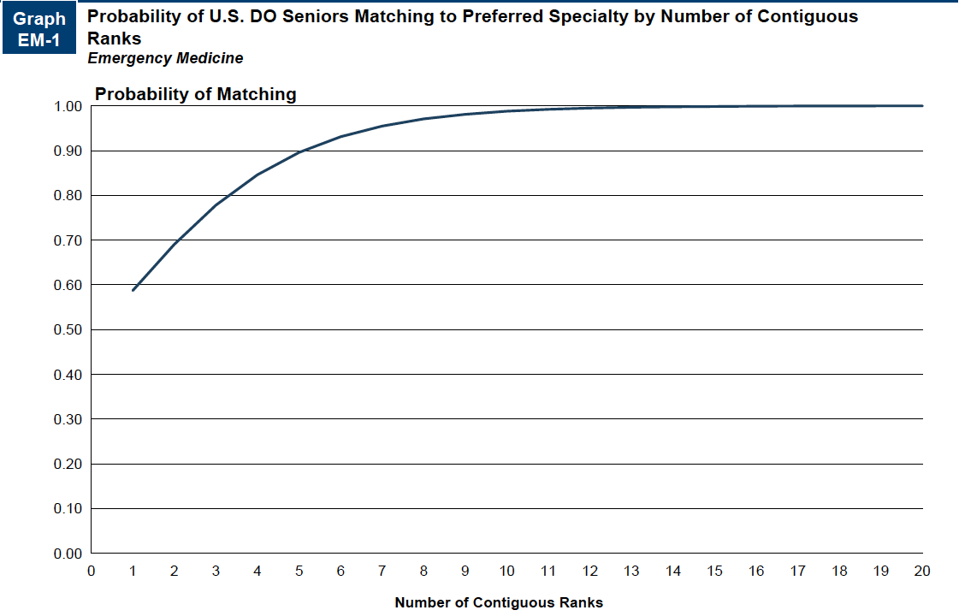
Probability of Matching Based on Number of Programs Ranked​
Source​: Charting Outcomes in the Match: Senior Students of U.S. DO Medical Schools 2024

Slide 10
Emergency Medicine Resources
Careers in Medicine Website
EMRA/CORD Student Advising Guide
American College of Osteopathic Emergency Physicians
American College of Emergency Physicians
Mentorship Opportunities:
  Emergency Medicine Residents Association (EMRA)
  American College of Emergency Physicians (ACEP)

