Slide 1
Family Medicine

Slide 2
Family Medicine Overview
Family medicine physicians are at the forefront of providing primary care to individuals and families in the United States. Family medicine physicians form the core of primary care because of the broad clinical knowledge base they are called to draw upon in their practice.
Family medicine physicians can competently diagnose and treat patients presenting with a disparate assortment of clinical and social issues. Because of the breadth of its scope, family medicine offers a wide variety of contexts and experiences to physicians who take up the specialty.
Source ​
Bonacci, R. P., Erickson, J., & Lally, M. (2015). Family medicine. In J. W. Kung, P. M. Bishop, P. J. Slanetz, & R. L. Eisenberg (Eds.), Tips for the residency match: What residency directors are really looking for (pp. 58-61). Malden: Wiley Blackwell. ​​
​
Mendoza, M., & Gravitz, Z. (2019). Family medicine. In B. S. Freeman (Ed.), The ultimate guide to choosing a medical specialty (4 ed., pp. 207-223). New York: McGraw Hill. ​

Slide 3
Family Medicine Subspecialties
Clinical Informatics
Geriatric Medicine
Hospice & Palliative Care
Sports Medicine
Source​
Accreditation Council for Graduate Medical Education (ACGME)

Slide 4
Family Medicine Data Overview​
Number of Accredited Residency Programs (2024)¹ | 771
Percentage of Programs Often Interviewing DOs (2024)² | 93%
Typical Length of Residency Training | 3 Years
Preliminary Year Required | No
Mean COMLEX Level 2 CE Score (2024)³ | 507
Mean USMLE Step 2 Score (2024)³ | 240
Program Signals (2024/2025 Application Cycle)⁴ | 5
Mean Research Experience (2024)³ | 1.6
Mean Publications, Presentations (2024)³ | 2.8
Mean Number of Work Experiences (2024)³ | 2.2
Mean Number of Volunteer Experiences (2024)³ | 4.4
Average Hours Worked Per Week⁵ | 52.6
Median Salary⁵ | $240,000
Sources​
Accreditation Council for Graduate Medical Education (ACGME)​
Results of the 2024 NRMP Program Director Survey​
Charting Outcomes in the Match: Senior Students of U.S. DO Medical Schools​
ERAS Application and Program Signaling for 2024-2025
Careers in Medicine​

Slide 5
Top Factors Considered by Program Directors for Choosing Interviewees​
Personal Statement (90%)
USMLE Step 1 pass (89%)
Perceived commitment to specialty (86%)
COMLEX Level 1 pass (85%)
Letters of recommendation in the specialty (82%)
MSPE/Dean's Letter (80%)
Any failed attempt in USMLE (80%)
Any failed attempt in COMLEX (80%)
History of having overcome significant obstacles (79%)
USMLE Step 2 CK score (76%)
COMLEX Level 2 CE score (73%)
Diversity characteristics (72%)
Leadership qualities (69%)
Volunteer/extracurricular experiences (67%)
Other life experience (67%)
Personal prior knowledge of the applicant (65%)
Geographic preferences (64%)
Evidence of professionalism and ethics (60%)
Audition elective/rotation within your department (59%)
Receipt of program preference signal (57%)
Evidence of continuous medical education without gaps (57%)
Source​
Results of the 2024 NRMP Program Director Survey

Slide 6
COMLEX Level 2 CE Score Ranges (2024)​
Source​: Charting Outcomes in the Match: Senior Students of U.S. DO Medical Schools 2024

Slide 7
USMLE Step 2 CK Score Ranges (2024)​
Source​: Charting Outcomes in the Match: Senior Students of U.S. DO Medical Schools 2024

Slide 8
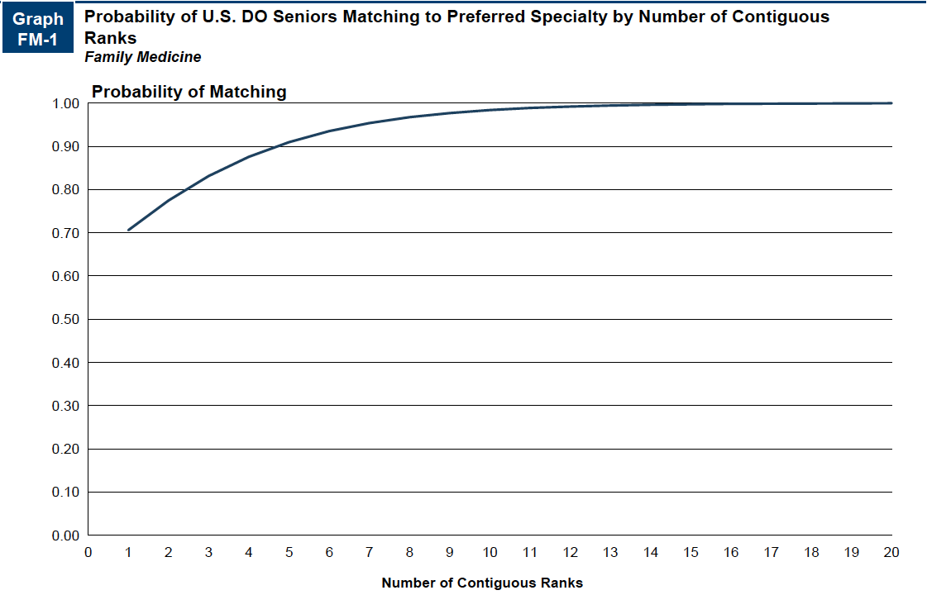
Probability of Matching Based on Number of Programs Ranked​
Source​: Charting Outcomes in the Match: Senior Students of U.S. DO Medical Schools 2024

Slide 9
Family Medicine Resources
Careers in Medicine Website
American College of Osteopathic Family Physicians
American Academy of Family Physicians
Medical Student Resources
Mentorship Opportunities
  American Academy of Family Physicians (AAFP)

