Slide 1
Neurological Surgery

Slide 2
Neurological Surgery Overview
Neurological surgeons are specialized physicians who diagnose and treat conditions affecting the central and peripheral nervous systems, including the brain and spinal cord. Their work encompasses a wide range of disorders, from brain tumors and spinal cord injuries to epilepsy and Parkinson's disease. These surgeons undergo extensive training, typically completing medical school followed by a residency in neurological surgery, which may last around six to eight years. Neurological surgeons possess a deep understanding of neuroanatomy and utilize advanced surgical techniques, such as microsurgery and neuroendoscopy, to perform intricate procedures with precision and minimize damage to surrounding tissues.

Slide 3
Neurological Surgery Cont'd
In their daily practice, neurological surgeons assess patients through thorough examinations, imaging studies and diagnostic tests to formulate treatment plans. They may perform surgeries to remove brain tumors, repair spinal cord injuries, alleviate pressure on nerves caused by conditions like herniated discs or implant devices such as deep brain stimulators for Parkinson's disease management. Beyond surgical interventions, they also offer guidance on non-surgical treatment options, including medication management and rehabilitation therapies, to optimize patient outcomes.
Source
Shahlaie, K. (2019). Neurosurgery. In B. S. Freeman (Ed.), The ultimate guide to choosing a medical specialty (4 ed., pp. 293-310). New York: McGraw Hill.

Slide 4
​Neurological Surgery Subspecialties
Neuroendovascular Intervention
Source​
Accreditation Council for Graduate Medical Education (ACGME)

Slide 5
Neurological Surgery Data Overview​
Number of Accredited Residency Programs (2024)¹ | 118
Percentage of Programs Often Interviewing DOs (2024)² | 7%
Typical Length of Residency Training | 7 Years
Preliminary Year Required | No
Mean COMLEX Level 2 CE Score (2024)³ | 686
Mean USMLE Step 2 Score (2024)³ | 256
Program Signals (2024/2025 Application Cycle)⁴ | 25
Mean Research Experience (2024)³ | 4.0
Mean Publications, Presentations (2024)³ | 23.0
Mean Number of Work Experiences (2024)³ | 2.5
Mean Number of Volunteer Experiences (2024)³ | 2.0
Average Hours Worked Per Week⁵ | 58.2
Median Salary⁵ | $734,000
Sources​
Accreditation Council for Graduate Medical Education (ACGME)​
Results of the 2024 NRMP Program Director Survey​
Charting Outcomes in the Match: Senior Students of U.S. DO Medical Schools​
ERAS Application and Program Signaling for 2024-245
Careers in Medicine​

Slide 6
Top Factors Considered by Program Directors for Choosing Interviewees​
USMLE Step 1 pass (100%)
Demonstrated involvement and interest in research (100%)
USMLE Step 2 CK score (93%)
Letters of recommendation in the specialty (93%)
Leadership qualities (93%)
Audition elective/rotation within your department (93%)
History of having overcome significant obstacles (86%)
Grades in required clerkships (86%)
Personal prior knowledge of the applicant (79%)
MSPE/Dean's Letter (79%)
Grades in clerkship in desired specialty (79%)
Volunteer/extracurricular experiences (71%)
Personal Statement (71%)
Perceived commitment to specialty (71%)
Class ranking/quartile (71%)
Awards or special honors in clinical clerkships (71%)
Receipt of preference (program) signal (64%)
Other life experience (64%)
Away rotation in your specialty at another institution (64%)
Awards or special honors in neurosurgery (64%)
Alpha Omega Alpha (AOA) membership (64%)
Evidence of professionalism and ethics (64%)
Diversity characteristics (57%)
Any failed attempt in USMLE (57%)
Source​
Results of the 2024 NRMP Program Director Survey

Slide 7
COMLEX Level 2 CE Score Ranges (2022)​
Source​: Charting Outcomes in the Match: Senior Students of U.S. DO Medical Schools 2024

Slide 8
USMLE Step 2 CK Score Ranges (2022)​
Source​: Charting Outcomes in the Match: Senior Students of U.S. DO Medical Schools 2024

Slide 9
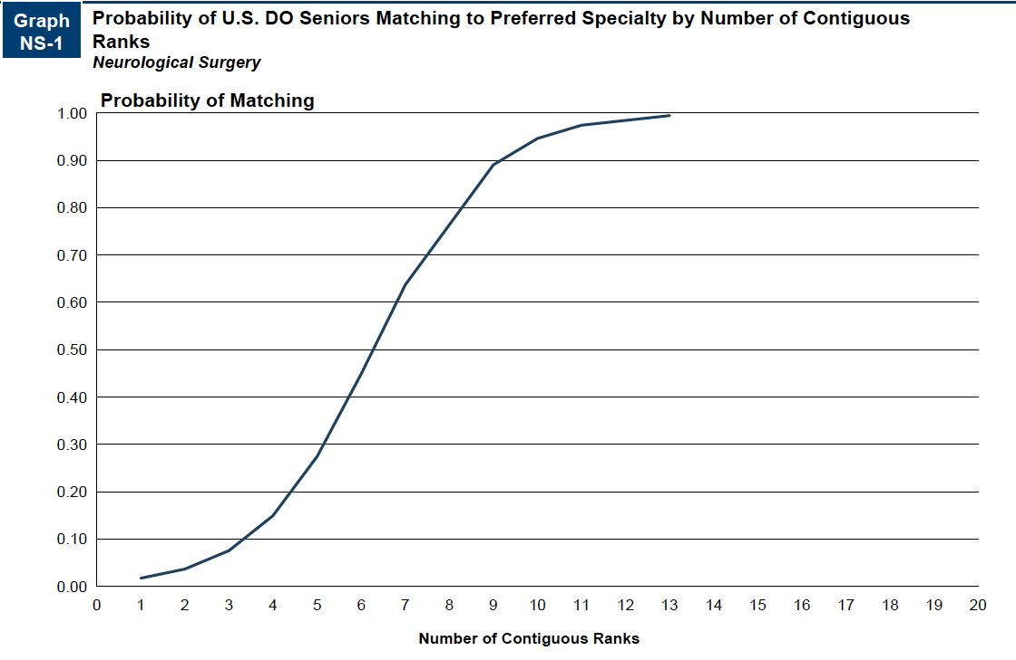
Probability of Matching Based on Number of Programs Ranked​
Source​: Charting Outcomes in the Match: Senior Students of U.S. DO Medical Schools 2024

Slide 10
Neurological Surgery Resources
Careers in Medicine Website
American College of Osteopathic Surgeons
American Association of Neurological Surgeons
Neurosurgery Match Resources
Mentorship Opportunities:
  American College of Osteopathic Surgeons (ACOS)

