Slide 1
Neurology

Slide 2
Neurology Overview
Neurological surgeons are specialized physicians who diagnose and treat conditions affecting the central and peripheral nervous systems, including the brain and spinal cord. Their work encompasses a wide range of disorders, from brain tumors and spinal cord injuries to epilepsy and Parkinson's disease. These surgeons undergo extensive training, typically completing medical school followed by a residency in neurological surgery, which may last around six to eight years. Neurological surgeons possess a deep understanding of neuroanatomy and utilize advanced surgical techniques, such as microsurgery and neuroendoscopy, to perform intricate procedures with precision and minimize damage to surrounding tissues.
Sources
Wheeler, N., & London, Z. N. (2015). Neurology. In J. W. Kung, P. M. Bishop, P. J. Slanetz, & R. L. Eisenberg (Eds.), Tips for the residency match: What program directors are really looking for (pp. 81-87). Malden: Wiley Blackwell. ​
Zabiega, T. (2019). Neurology. In B. S. Freeman (Ed.), The ultimate guide to choosing a medical specialty (4 ed., pp. 279-292). New York: McGraw Hill.

Slide 3
​Neurology Subspecialties
Clinical Neurophysiology
Epilepsy
Neurocritical Care
Neuroendovascular Intervention
Neurodevelopmental Disabilities
Neuromuscular Medicine
Vascular Neurology
Source​
Accreditation Council for Graduate Medical Education (ACGME)

Slide 4
Neurology Data Overview​
Number of Accredited Residency Programs (2024)¹ | 183
Percentage of Programs Often Interviewing DOs (2024)² | 73%
Typical Length of Residency Training | 4 Years
Preliminary Year Required | Yes*
Mean COMLEX Level 2 CE Score (2024)³ | 551
Mean USMLE Step 2 Score (2024)³ | 245
Program Signals (2024/2025 Application Cycle)⁴ | 8
Mean Research Experience (2024)³ | 2.4
Mean Publications, Presentations (2024)³ | 2.6
Mean Number of Work Experiences (2024)³ | 1.9
Mean Number of Volunteer Experiences (2024)³ | 4.0
Average Hours Worked Per Week⁵ | 50.8
Median Salary⁵ | $295,000
Sources​
Accreditation Council for Graduate Medical Education (ACGME)​
Results of the 2024 NRMP Program Director Survey​
Charting Outcomes in the Match: Senior Students of U.S. DO Medical Schools​
ERAS Application and Program Signaling for 2024-2025
Careers in Medicine​
​Note
*Some neurology programs require a preliminary year (advanced programs), while others do not (categorical programs).

Slide 5
Top Factors Considered by Program Directors for Choosing Interviewees​
USMLE Step 1 pass (94%)
MSPE/Dean's Letter (94%)
Letters of recommendation in the specialty (90%)
Any failed attempt in USMLE (87%)
USMLE Step 2 CK score (84%)
Perceived commitment to specialty (84%)
Personal Statement (77%)
Any failed attempt in COMLEX (74%)
Geographic preferences (71%)
History of having overcome significant obstacles (68%)
Grades in required clerkships (65%)
Evidence of continuous medical education without gaps (65%)
Class ranking/quartile (65%)
Grades in clerkship in desired specialty (61%)
Diversity characteristics (61%)
COMLEX Level 1 pass (61%)
Evidence of professionalism and ethics (61%)
Personal prior knowledge of the applicant (58%)
Other life experience (58%)
Leadership qualities (58%)
Consistency of grades (58%)
Source​
Results of the 2024 NRMP Program Director Survey

Slide 6
COMLEX Level 2 CE Score Ranges (2024)​
Source​
Results of the 2024 NRMP Program Director Survey

Slide 7
USMLE Step 2 CK Score Ranges (2024)​
Source​
Results of the 2024 NRMP Program Director Survey

Slide 8
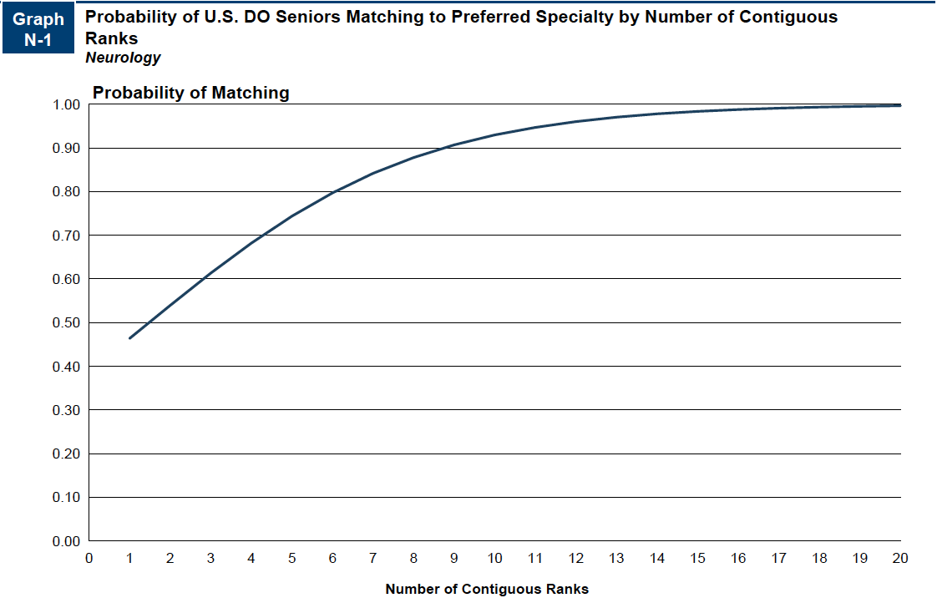
Probability of Matching Based on Number of Programs Ranked​
Source​
Results of the 2024 NRMP Program Director Survey

Slide 9
Neurology Resources
Careers in Medicine Website
American College of Osteopathic Neurologists and Psychiatrists
American Academy of Neurology
Medical Student Resources
Mentorship Opportunities:
  American Neurological Association (ANA Futures)
  American Neurological Association (ANA Ascend)

