Slide 1
Obstetrics & Gynecology

Slide 2
Obstetrics & Gynecology Overview
Obstetrics and gynecology (OB-GYN) delivers specialized medical care for , with obstetrics focusing on medical care before, during and after birth, and gynecology focusing on disorders affecting the reproductive system. OB-GYN requires physicians to have medical, obstetrical and surgical expertise in order to provide lifelong care to patients.
OB-GYN physicians also regularly treat urinary and sexual dysfunction, sexually transmitted diseases, infertility, pain disorders, menopausal symptoms and psychosocial issues, such as domestic abuse. Surgical procedures performed by OB-GYN physicians include laparotomy and laparoscopy.

Slide 3
Obstetrics & Gynecology Cont'd
OB-GYN physicians are adept at dealing with sensitive subjects and tense situations, can make quick but well-considered decisions, and are strong advocates for their patients.
Sources
Dunn, K., Miller, C., & Yvette, L. D. (2015). Obstetrics and gynecology. In J. W. Kung, P. M. Bishop, P. J. Slanetz, & R. L. Eisenberg (Eds.), Tips for the residency match: What residency directors are really looking for (pp. 89-92). Malden: Wiley Blackwell.
Elmore, K. O. (2019). Obstetrics and gynecology. In B. S. Freeman (Ed.), The ultimate guide to choosing a medical specialty (4 ed., pp. 311-323). New York: McGraw Hill.

Slide 4
Obstetrics & Gynecology Subspecialties
Female Pelvic Medicine & Reconstructive Surgery
Gynecologic Oncology
Maternal-Fetal Medicine
Reproductive Endocrinology & Infertility
Complex Family Planning
Source​
Accreditation Council for Graduate Medical Education (ACGME)

Slide 5
Obstetrics & Gynecology Data Overview​
Number of Accredited Residency Programs (2024)¹ | 298
Percentage of Programs Often Interviewing DOs (2024)² | 55%
Typical Length of Residency Training | 4 Years
Preliminary Year Required | No
Mean COMLEX Level 2 CE Score (2024)³ | 576
Mean USMLE Step 2 Score (2024)³ | 245
Program Signals (2024/2025 Application Cycle)⁴ | 18 (3 gold, 15 silver)
Mean Research Experience (2024)³ | 3.1
Mean Publications, Presentations (2024)³ | 6.4
Mean Number of Work Experiences (2024)³ | 2.2
Mean Number of Volunteer Experiences (2024)³ | 4.8
Average Hours Worked Per Week⁵ | 58
Median Salary⁵ | $327,000
Sources​
Accreditation Council for Graduate Medical Education (ACGME)​
Results of the 2024 NRMP Program Director Survey​
Charting Outcomes in the Match: Senior Students of U.S. DO Medical Schools​
ERAS Application and Program Signaling for 2024-2025
Careers in Medicine​

Slide 6
Top Factors Considered by Program Directors for Choosing Interviewees​
USMLE Step 1 pass (94%)
USMLE Step 2 CK score (91%)
MSPE/Dean's Letter (89%)
Letters of recommendation in the specialty (86%)
Personal Statement (85%)
History of having overcome significant obstacles (83%)
Leadership qualities (82%)
Diversity characteristics (80%)
Receipt of program preference signal (79%)
Grades in required clerkships (76%)
Grades in clerkship in desired specialty (76%)
Evidence of professionalism and ethics (76%)
Any failed attempt in USMLE (74%)
Volunteer/extracurricular experiences (68%)
Perceived commitment to specialty (67%)
Other life experience (64%)
Class ranking/quartile (64%)
Gold Humanism Honor Society (GHHS) membership (62%)
Audition elective/rotation at the program (59%)
Consistency of grades (56%)
Awards or special honors in clinical clerkships (56%)
Source​
Results of the 2024 NRMP Program Director Survey

Slide 7
COMLEX Level 2 CE Score Ranges (2024)​
Source​
Results of the 2024 NRMP Program Director Survey

Slide 8
USMLE Step 2 CK Score Ranges (2024)​
Source​
Results of the 2024 NRMP Program Director Survey

Slide 9
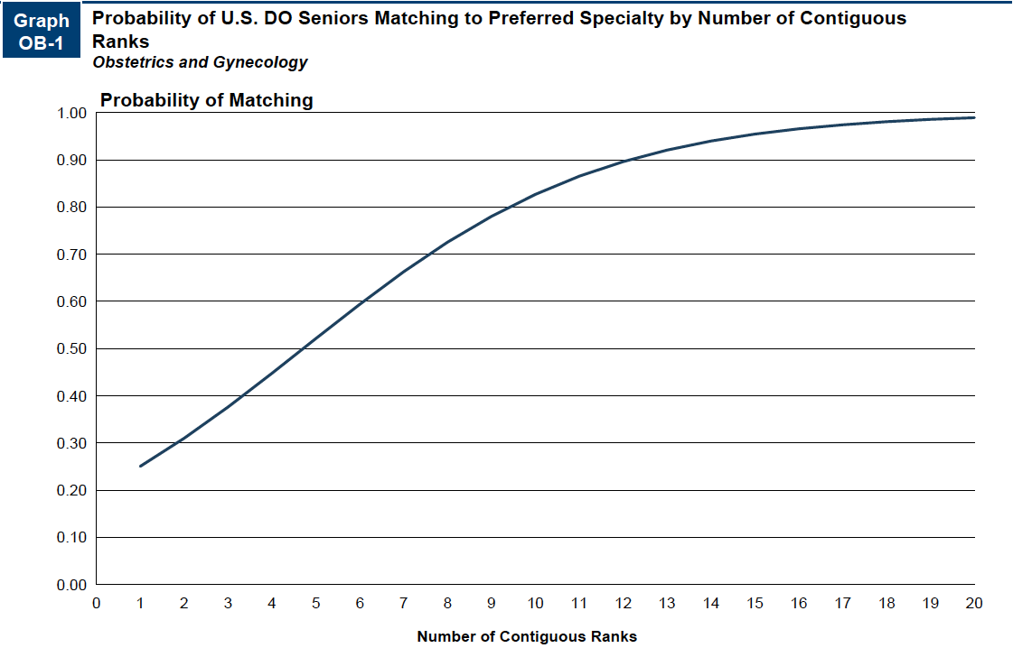
Probability of Matching Based on Number of Programs Ranked​
Source​
Results of the 2024 NRMP Program Director Survey

Slide 10
Obstetrics & Gynecology Resources
Careers in Medicine Website
American College of Osteopathic Obstetricians and Gynecologists
American College of Obstetricians and Gynecologists
Residency Application Resources
Mentorship Opportunities:
  American College of Obstetricians and Gynecologists (ACOG)
  American College of Osteopathic Obstetricians and Gynecologists (ACOOG)

