Slide 1
Otolaryngology

Slide 2
Otolaryngology Overview
Otolaryngologists, commonly referred to as ENT (ear, nose and throat) specialists, are physicians specialized in the diagnosis and treatment of disorders related to the head and neck region. Their work encompasses a diverse range of conditions, including ear infections, sinusitis, tonsillitis, voice disorders, and head and neck cancers. These specialists undergo extensive training, completing medical school followed by a residency in otolaryngology, which typically lasts around five to six years. They possess comprehensive knowledge of the anatomy and physiology of the ear, nose, throat and related structures, allowing them to effectively diagnose and manage various disorders through medical, surgical and minimally invasive interventions.

Slide 3
Otolaryngology Cont'd
In their daily practice, otolaryngologists evaluate patients through detailed medical histories, physical examinations and diagnostic tests such as endoscopy and imaging studies. They provide personalized treatment plans tailored to each patient's needs, which may include medications, surgical procedures or therapeutic interventions like speech therapy. Otolaryngologists are skilled in a wide range of surgical techniques, from routine procedures like tonsillectomy and sinus surgery to complex operations such as cochlear implantation and head and neck cancer resection.
Source ​
Joshi, A., & Tanna, N. (2019). Otolaryngology. In B. S. Freeman (Ed.), The ultimate guide to choosing a medical specialty (4 ed., pp. 351-364). New York: McGraw Hill.​
​
Judson, B. L., Paskhover, B., & Michaelides, E. M. (2015). Otolaryngology. In J. W. Kung, P. M. Bishop, P. J. Slanetz, & R. L. Eisenberg (Eds.), Tips for the residency match: What residency directors are really looking for (pp. 103-108). Malden: Wiley Blackwell.​

Slide 4
Otolaryngology Subspecialties
Neurotology
Pediatric Otolaryngology
Source​
Accreditation Council for Graduate Medical Education (ACGME)

Slide 5
Otolaryngology Data Overview​
Number of Accredited Residency Programs (2024)¹ | 131
Percentage of Programs Often Interviewing DOs (2024)² | 10%
Typical Length of Residency Training | 5-6 Years
Preliminary Year Required | No
Mean COMLEX Level 2 CE Score (2024)³ | 581
Mean USMLE Step 2 Score (2024)³ | 248
Program Signals (2024/2025 Application Cycle)⁴ | 25
Mean Research Experience (2024)³ | 4.5
Mean Publications, Presentations (2024)³ | 11.3
Mean Number of Work Experiences (2024)³ | 3.1
Mean Number of Volunteer Experiences (2024)³ | 6.5
Average Hours Worked Per Week⁵ | 53
Median Salary⁵ | $444,264
Sources​
Accreditation Council for Graduate Medical Education (ACGME)​
Results of the 2024 NRMP Program Director Survey​
Charting Outcomes in the Match: Senior Students of U.S. DO Medical Schools​
ERAS Application and Program Signaling for 2024-2025
Careers in Medicine​

Slide 6
Top Factors Considered by Program Directors for Choosing Interviewees​
Receipt of program preference signal (100%)
Letters of recommendation in the specialty (100%)
MSPE/Dean's Letter (95%)
Personal Statement (90%)
USMLE Step 2 CK score (85%)
Grades in required clerkships (85%)
USMLE Step 1 pass (80%)
Leadership qualities (75%)
Class ranking/quartile (75%)
Audition elective/rotation at the program (75%)
Demonstrated involvement and interest in research (75%)
Perceived commitment to specialty (70%)
History of having overcome significant obstacles (70%)
Awards or special honors in clinical clerkships (70%)
Volunteer/extracurricular experiences (65%)
Personal prior knowledge of the applicant (65%)
Grades in clerkship in desired specialty (65%)
Gold Humanism Honor Society (GHHS) membership (65%)
Alpha Omega Alpha (AOA) membership (65%)
Evidence of professionalism and ethics (65%)
Source​
Results of the 2024 NRMP Program Director Survey

Slide 7
COMLEX Level 2 CE Score Ranges (2024)​
Source​: Charting Outcomes in the Match: Senior Students of U.S. DO Medical Schools 2024

Slide 8
USMLE Step 2 CK Score Ranges (2024)​
Source​: Charting Outcomes in the Match: Senior Students of U.S. DO Medical Schools 2024

Slide 9
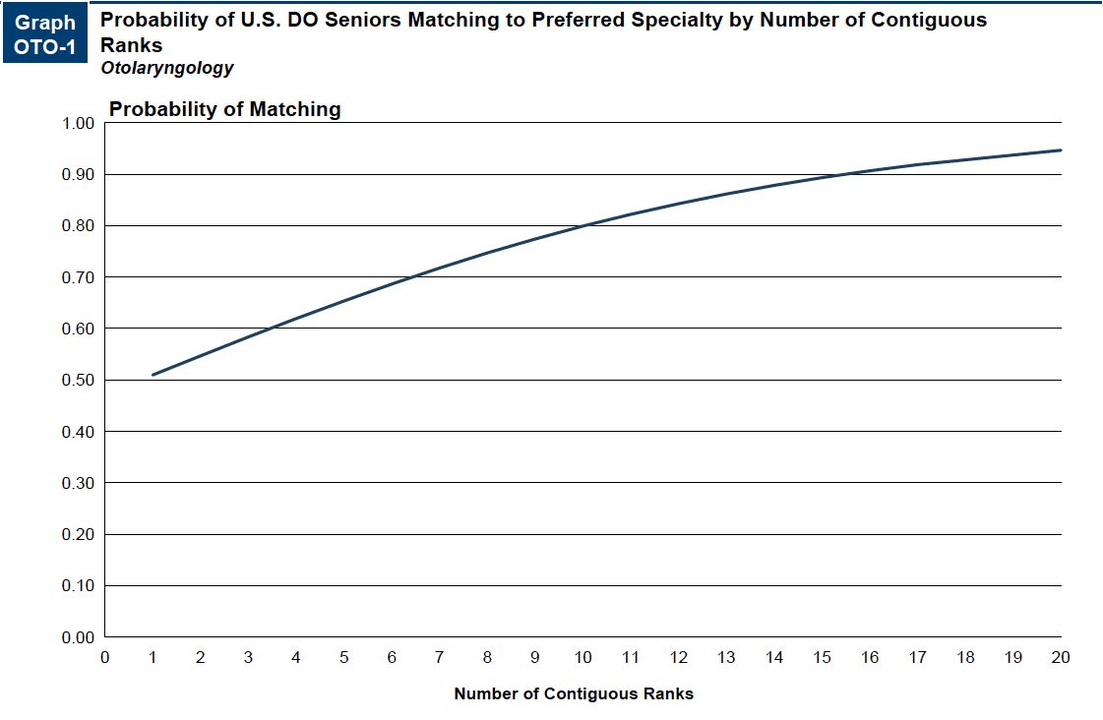
Probability of Matching Based on Number of Programs Ranked​
Source​: Charting Outcomes in the Match: Senior Students of U.S. DO Medical Schools 2024

Slide 10
Otolaryngology Resources
Careers in Medicine Website
American Osteopathic Colleges of Ophthalmology and Otolaryngology-Head and Neck Surgery
American Academy of Otolaryngology-Head and Neck Surgery
How do I match in Otolaryngology?
Mentorship Opportunities:
  American Academy of Otolaryngology-Head and Neck Surgery (AAO HNS)

