Slide 1
Pathology

Slide 2
Pathology Overview
A pathologist deals with the causes and nature of disease and contributes to diagnosis, prognosis and treatment through knowledge gained by the laboratory application of the biological, chemical and physical sciences.
Pathologists use information gathered from the microscopic examination of tissue specimens, cells and body fluids and from clinical laboratory tests on body fluids and secretions for the diagnosis, exclusion and monitoring of disease. They focus on the analysis of bodily fluids, such as blood, urine and cerebrospinal fluid, as well as on laboratory tests, such as blood chemistry, microbiology and molecular diagnostics.

Slide 3
Pathology Cont'd
Pathologists interpret the results of these tests to diagnose and monitor various diseases, including infections, metabolic disorders, autoimmune conditions and cancer. They can also specialize in performing autopsies, which involve the postmortem examination of deceased individuals to determine the cause of death and identify any underlying diseases or injuries.
Sources
American Board of Medical Specialties (Last accessed 2023)

Slide 4
Pathology Subspecialties
Blood Banking/Transfusion Medicine
Chemical Pathology
Clinical Informatics
Cytopathology
Forensic Pathology
Hematopathology
Medical Microbiology
Neuropathology
Pediatric Pathology
Selective Pathology
Source​
Accreditation Council for Graduate Medical Education (ACGME)

Slide 5
Pathology Data Overview​
Number of Accredited Residency Programs (2024)¹ | 141
Percentage of Programs Often Interviewing DOs (2024)² | 88%
Typical Length of Residency Training | 4 Years
Preliminary Year Required | No
Mean COMLEX Level 2 CE Score (2024)³ | 547
Mean USMLE Step 2 Score (2024)³ | 245
Program Signals (2024/2025 Application Cycle)⁴ | 5
Mean Research Experience (2024)³ | 2.1
Mean Publications, Presentations (2024)³ | 6.3
Mean Number of Work Experiences (2024)³ | 2.4
Mean Number of Volunteer Experiences (2024)³ | 3.5
Average Hours Worked Per Week⁵ | 47.1
Median Salary⁵ | $308,000
Sources​
Accreditation Council for Graduate Medical Education (ACGME)​
Results of the 2024 NRMP Program Director Survey​
Charting Outcomes in the Match: Senior Students of U.S. DO Medical Schools​
ERAS Application and Program Signaling for 2024-2025
Careers in Medicine​

Slide 6
Top Factors Considered by Program Directors for Choosing Interviewees​
USMLE Step 1 pass (96%)
Perceived commitment to specialty (92%)
Letters of recommendation in the specialty (92%)
USMLE Step 2 CK score (88%)
Personal Statement (88%)
MSPE/Dean's Letter (84%)
Diversity characteristics (80%)
Any failed attempt in USMLE (80%)
Any failed attempt in COMLEX (76%)
History of having overcome significant obstacles (72%)
COMLEX Level 2 CE score (72%)
COMLEX Level 1 pass (72%)
Geographic preferences (72%)
Personal prior knowledge of the applicant (68%)
Leadership qualities (68%)
Evidence of professionalism and ethics (68%)
Class ranking/quartile (64%)
Demonstrated involvement and interest in research (64%)
Receipt of program preference signal (60%)
Grades in clerkship in desired specialty (60%)
Awards or special honors in clinical clerkships (60%)
Awards or honors in clerkship in desired specialty (60%)
Audition elective/rotation at the program (60%)
Source​
Results of the 2024 NRMP Program Director Survey

Slide 7
COMLEX Level 2 CE Score Ranges (2024)​
Source​: Charting Outcomes in the Match: Senior Students of U.S. DO Medical Schools 2024

Slide 8
USMLE Step 2 CK Score Ranges (2024)​
Source​: Charting Outcomes in the Match: Senior Students of U.S. DO Medical Schools 2024

Slide 9
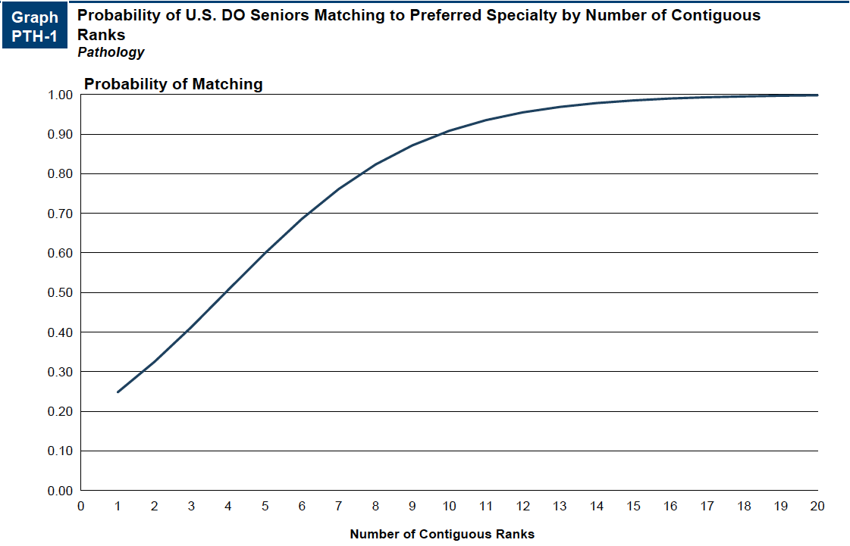
Probability of Matching Based on Number of Programs Ranked​
Source​: Charting Outcomes in the Match: Senior Students of U.S. DO Medical Schools 2024

Slide 10
Pathology Resources
Careers in Medicine Website
American Osteopathic College of Pathologists
College of American Pathologists
Medical Student Resources
Mentorship Opportunities:
  American Osteopathic College of Pathologists (AOCP)

