Slide 1
Pediatrics

Slide 2
Pediatrics Overview
A career in pediatrics starts with one question: Do you like working with children? Working with children is both the joy and challenge of pediatrics as a medical specialty. For those who enjoy working with children, the attraction of the specialty is immediately obvious.
However, challenges such as working with a population that cannot always adequately describe their symptoms require the development of a new set of skills for those who choose this specialty. Primary care pediatricians have a unique opportunity to help their patients overcome not only medical issues but also issues affecting their mental and emotional health as they develop and grow.

Slide 3
Pediatrics Cont'd
Pediatricians must also have good general people skills, as they will be regularly dealing with the parents of their patients, who are often considered the "second patient" in pediatric visits.
Sources
Miller, A. J. (2019). Pediatrics. In B. S. Freeman (Ed.), The ultimate guide to choosing a medical specialty (4 ed., pp. 383-399). New York: McGraw Hill.

Slide 4
Pediatrics Subspecialties​
Pediatric Gastroenterology
Pediatric Hematology/Oncology
Pediatric Infectious Diseases
Pediatric Nephrology
Pediatric Pulmonology
Pediatric Rheumatology
Sports Medicine
Pediatric Transplant Hepatology
Pediatric Hospital Medicine
Adolescent Medicine
Child Abuse Pediatrics
Clinical Informatics
Developmental-Behavioral Pediatrics
Neonatal-Perinatal Medicine
Pediatric Cardiology
Pediatric Critical Care Medicine
Pediatric Emergency Medicine
Pediatric Endocrinology
Source​
Accreditation Council for Graduate Medical Education (ACGME)

Slide 5
Pediatrics Data Overview​
Number of Accredited Residency Programs (2024)¹ | 216
Percentage of Programs Often Interviewing DOs (2024)² | 87%
Typical Length of Residency Training | 3 Years
Preliminary Year Required | No
Mean COMLEX Level 2 CE Score (2024)³ | 534
Mean USMLE Step 2 Score (2024)³ | 241
Program Signals (2024/2025 Application Cycle)⁴ | 5
Mean Research Experience (2024)³ | 1.8
Mean Publications, Presentations (2024)³ | 3.6
Mean Number of Work Experiences (2024)³ | 2.1
Mean Number of Volunteer Experiences (2024)³ | 5.3
Average Hours Worked Per Week⁵ | 47
Median Salary⁵ | $221,000
Sources​
Accreditation Council for Graduate Medical Education (ACGME)​
Results of the 2024 NRMP Program Director Survey​
Charting Outcomes in the Match: Senior Students of U.S. DO Medical Schools​
ERAS Application and Program Signaling for 2024-2025
Careers in Medicine​

Slide 6
Top Factors Considered by Program Directors for Choosing Interviewees​
SMLE Step 1 pass (94%)
MSPE/Dean's Letter (90%)
Diversity characteristics (79%)
COMLEX Level 1 pass (79%)
Any failed attempt in USMLE (79%)
Any failed attempt in COMLEX (75%)
Receipt of program preference signal (73%)
History of having overcome significant obstacles (73%)
Leadership qualities (69%)
USMLE Step 2 CK score (67%)
Class ranking/quartile (65%)
Geographic preferences (65%)
Evidence of professionalism and ethics (65%)
Letters of recommendation in the specialty (63%)
Audition elective/rotation at the program (63%)
Volunteer/extracurricular experiences (60%)
Personal Statement (60%)
COMLEX Level 2 CE score (56%)
Grades in required clerkships (54%)
Consistency of grades (52%)
Source​
Results of the 2024 NRMP Program Director Survey

Slide 7
COMLEX Level 2 CE Score Ranges (2024)​
Source​: Charting Outcomes in the Match: Senior Students of U.S. DO Medical Schools 2024

Slide 8
USMLE Step 2 CK Score Ranges (2024)​
Source​: Charting Outcomes in the Match: Senior Students of U.S. DO Medical Schools 2024

Slide 9
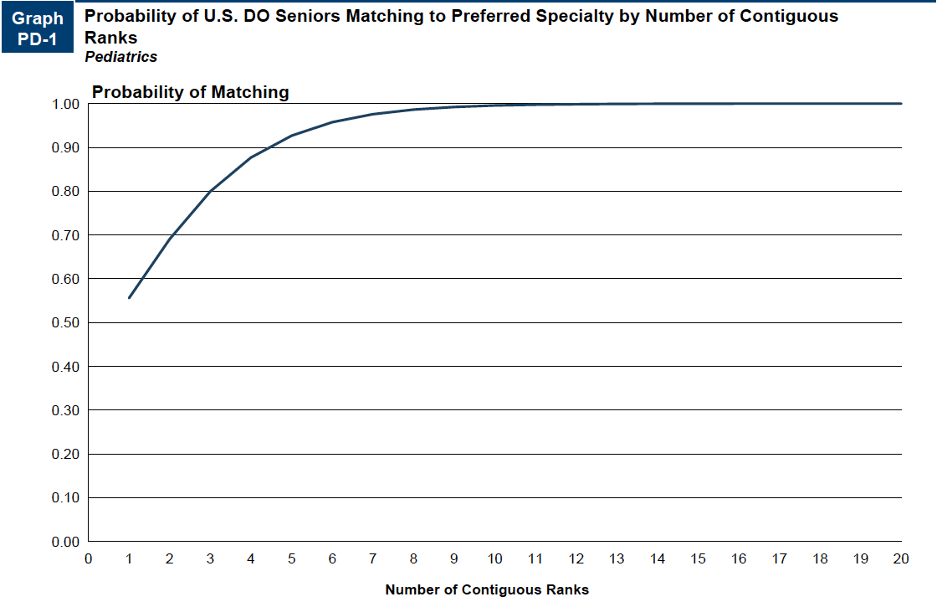
Probability of Matching Based on Number of Programs Ranked​
Source​: Charting Outcomes in the Match: Senior Students of U.S. DO Medical Schools 2024

Slide 10
Pediatrics Resources
Careers in Medicine Website
American College of Osteopathic Pediatricians
American Academy of Pediatrics
Medical Student Resources
Mentorship Opportunities:
  American College of Osteopathic Pediatricians (ACOP)
  American Academy of Pediatrics (AAP)

