Slide 1
Physical Medicine & Rehabilitation

Slide 2
Physical Medicine
& Rehabilitation Overview
Physical medicine and rehabilitation (PM&R) focuses on preventing, diagnosing and treating a wide array of musculoskeletal, cardiopulmonary and neurologic disorders by means of rehabilitative measures. Physiatrists focus on improving patients' quality of life and maximizing their functional independence through non-surgical interventions, rehabilitation therapies and interdisciplinary care.
Patients include those who have been affected by spinal cord injury, stroke, sports injury, traumatic brain injury, multiple sclerosis, muscular dystrophy, cerebral palsy and spina bifida. Physiatrists oversee and coordinate rehabilitation therapies aimed at improving patients' mobility, strength, coordination, balance, endurance and overall functional abilities.

Slide 3
Physical Medicine
& Rehabilitation Cont'd
Physiatrists (PM&R physicians) often work closely with other medical professionals as part of a team-oriented approach to patient care. Physiatrists enjoy caring for patients with chronic conditions, work well in interdisciplinary settings and enjoy being involved in their patients’ lives. kills, as they will be regularly dealing with the parents of their patients, who are often considered the "second patient" in pediatric visits.
Sources
Anderson, V. (2019). Physical medicine and rehabilitation. In B. S. Freeman (Ed.), The ultimate guide to choosing a medical specialty (4 ed., pp. 401-417). New York: McGraw Hill.
Bloch, R. (2015). Physical medicine and rehabilitation. In J. W. Kung, P. M. Bishop, P. J. Slanetz, & R. L. Eisenberg (Eds.), Tips for the residency match: What program directors are really looking for (pp. 119-122). Malden: Wiley Blackwell.

Slide 4
Physical Medicine &
Rehabilitation Subspecialties​
Brain Injury Medicine
Neuromuscular Medicine
Spinal Cord Injury Medicine
Pediatric Rehabilitation Medicine
Sports Medicine
Source​
Accreditation Council for Graduate Medical Education (ACGME)

Slide 5
Physical Medicine & Rehabilitation Data Overview​
Number of Accredited Residency Programs (2024)¹ | 112
Percentage of Programs Often Interviewing DOs (2024)² | 90%
Typical Length of Residency Training | 4 Years
Preliminary Year Required | Yes*
Mean COMLEX Level 2 CE Score (2024)³ | 547
Mean USMLE Step 2 Score (2024)³ | 241
Program Signals (2024/2025 Application Cycle)⁴ | 8
Mean Research Experience (2024)³ | 3.3
Mean Publications, Presentations (2024)³ | 6.8
Mean Number of Work Experiences (2024)³ | 2.5
Mean Number of Volunteer Experiences (2024)³ | 5.1
Average Hours Worked Per Week⁵ | 45.4
Median Salary⁵ | $262,000
Sources​
Accreditation Council for Graduate Medical Education (ACGME)​
Results of the 2024 NRMP Program Director Survey​
Charting Outcomes in the Match: Senior Students of U.S. DO Medical Schools​
ERAS Application and Program Signaling for 2024-2025
Careers in Medicine​
Note​​
*Some PM&R programs require a preliminary year (advanced programs), while others do not (categorical programs).​

Slide 6
Top Factors Considered by Program Directors for Choosing Interviewees​
SMLE Step 1 pass (100%)
Personal Statement (95%)
Perceived commitment to specialty (95%)
MSPE/Dean's Letter (95%)
Volunteer/extracurricular experiences (89%)
COMLEX Level 1 pass (89%)
Letters of recommendation in the specialty (84%)
Leadership qualities (84%)
Diversity characteristics (84%)
Geographic preferences (84%)
History of having overcome significant obstacles (79%)
Class ranking/quartile (79%)
USMLE Step 2 CK score (74%)
Grades in required clerkships (74%)
Grades in clerkship in desired specialty (74%)
Other life experience (68%)
COMLEX Level 2 CE score (68%)
Awards or special honors in clinical clerkships (68%)
Awards or honors in clerkship in desired specialty (68%)
Any failed attempt in USMLE (68%)
Any failed attempt in COMLEX (68%)
Evidence of professionalism and ethics (68%)
Source​
Results of the 2024 NRMP Program Director Survey

Slide 7
COMLEX Level 2 CE Score Ranges (2024)​
Source​: Charting Outcomes in the Match: Senior Students of U.S. DO Medical Schools 2024

Slide 8
USMLE Step 2 CK Score Ranges (2024)​
Source​: Charting Outcomes in the Match: Senior Students of U.S. DO Medical Schools 2024

Slide 9
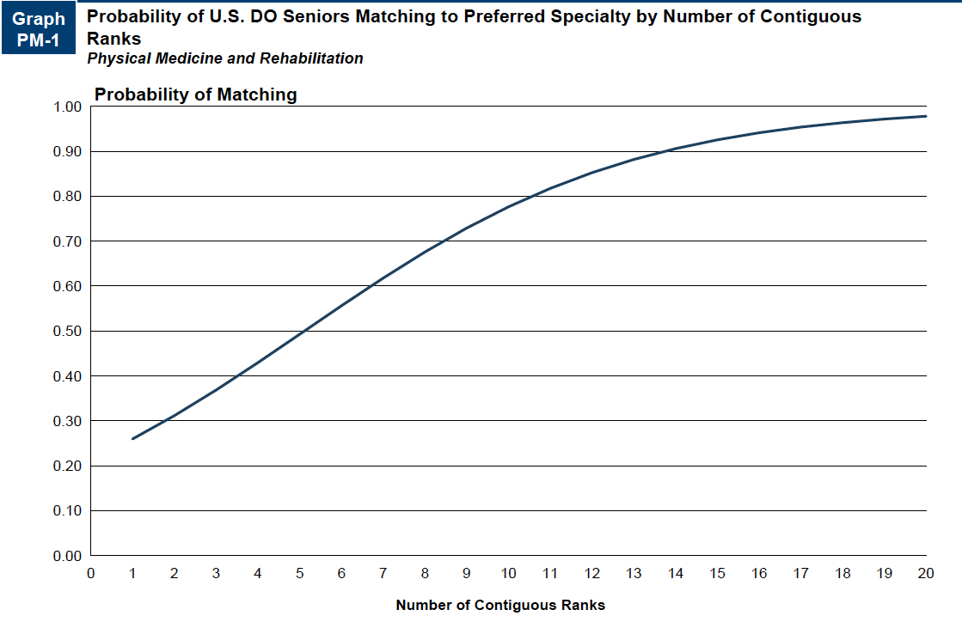
Probability of Matching Based on Number of Programs Ranked​
Source​: Charting Outcomes in the Match: Senior Students of U.S. DO Medical Schools 2024

Slide 10
Physical Medicine &
Rehabilitation Resources
Careers in Medicine Website
American Osteopathic College of Physical Medicine and Rehabilitation
American Academy of Physical Medicine and Rehabilitation
Medical Student Resources
Mentorship Opportunities:
  American Osteopathic College of Physical Medicine and Rehabilitation (AOCPMR)
  Association of Academic Physiatrists (AAP)

