Slide 1
Surgery - General

Slide 2
Surgery Overview
A general surgeon has principal expertise in the diagnosis and care of patients with diseases and disorders affecting the abdomen, digestive tract, endocrine system, breast, skin and blood vessels.
A general surgeon is also trained in the treatment of patients who are injured or critically ill, and in the care of pediatric and cancer patients. General surgeons are skilled in the use of minimally invasive techniques and endoscopies. Common conditions treated by general surgeons include hernias, gallstones, appendicitis, breast tumors, thyroid disorders, pancreatitis, bowel obstructions, colon inflammation and colon cancer.
Some general surgeons pursue additional training and specialize in the fields of pediatric surgery, surgical oncology, vascular surgery, trauma surgery, transplant surgery and others.
Sources​
American Board of Medical Specialties (Last accessed 2023)​

Slide 3
Surgery Subspecialties​
Complex General Surgical Oncology
Hand Surgery
Pediatric Surgery
Surgical Critical Care
Vascular Surgery – Independent
Source​
Accreditation Council for Graduate Medical Education (ACGME)

Slide 4
Surgery Data Overview​
Number of Accredited Residency Programs (2024)¹ | 364
Percentage of Programs Often Interviewing DOs (2024)² | 62%
Typical Length of Residency Training | 5 Years
Preliminary Year Required | No
Mean COMLEX Level 2 CE Score (2024)³ | 588
Mean USMLE Step 2 Score (2024)³ | 248
Program Signals (2024/2025 Application Cycle)⁴ | 15
Mean Research Experience (2024)³ | 3.5
Mean Publications, Presentations (2024)³ | 6.9
Mean Number of Work Experiences (2024)³ | 2.5
Mean Number of Volunteer Experiences (2024)³ | 4.5
Average Hours Worked Per Week⁵ | 59.4
Median Salary⁵ | $371,500
Sources​
Accreditation Council for Graduate Medical Education (ACGME)​
Results of the 2024 NRMP Program Director Survey​
Charting Outcomes in the Match: Senior Students of U.S. DO Medical Schools​
ERAS Application and Program Signaling for 2024-2025
Careers in Medicine​

Slide 5
Top Factors Considered by Program Directors for Choosing Interviewees​
USMLE Step 2 CK score (92%)
USMLE Step 1 pass (90%)
Personal Statement (88%)
Letters of recommendation in the specialty (88%)
Leadership qualities (85%)
Perceived commitment to specialty (83%)
MSPE/Dean's Letter (81%)
Diversity characteristics (80%)
History of having overcome significant obstacles (78%)
Grades in required clerkships (78%)
Grades in clerkship in desired specialty (78%)
Class ranking/quartile (73%)
Other life experience (71%)
Any failed attempt in USMLE (71%)
Volunteer/extracurricular experiences (68%)
Awards or special honors in clinical clerkships (68%)
Geographic preferences (66%)
Evidence of professionalism and ethics (64%)
Receipt of program preference signal (61%)
Personal prior knowledge of the applicant (61%)
Source​
Results of the 2024 NRMP Program Director Survey

Slide 6
COMLEX Level 2 CE Score Ranges (2024)​
Source​: Charting Outcomes in the Match: Senior Students of U.S. DO Medical Schools 2024

Slide 7
USMLE Step 2 CK Score Ranges (2024)​
Source​: Charting Outcomes in the Match: Senior Students of U.S. DO Medical Schools 2024

Slide 8
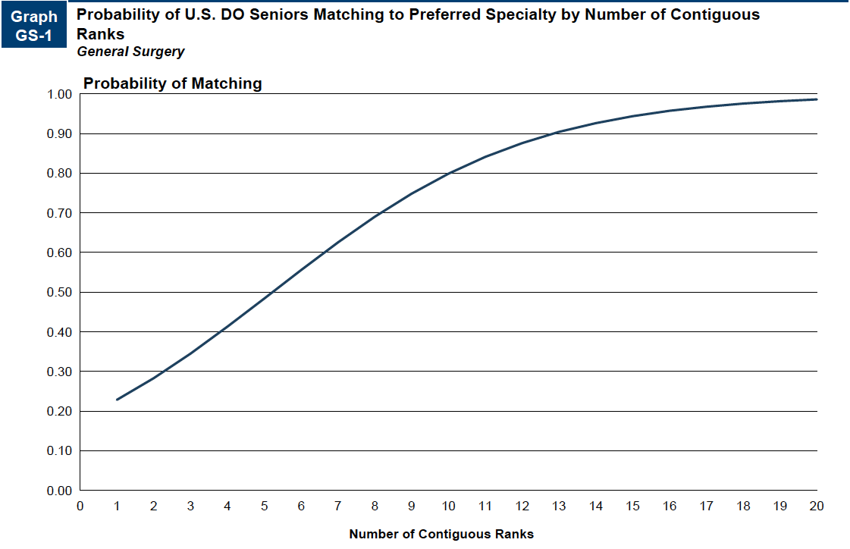
Probability of Matching Based on Number of Programs Ranked​
Source​: Charting Outcomes in the Match: Senior Students of U.S. DO Medical Schools 2024

Slide 9
Surgery Resources
Careers in Medicine Website
American College of Osteopathic Surgeons
American College of Surgeons
Medical Student Resources
Mentorship Opportunities:
  American College of Osteopathic Surgeons (ACOS)
  American College of Surgeons (ACS)

